Slide 1
2016.5.21
Reading Report
Reporter: Li Shuai

Slide 2
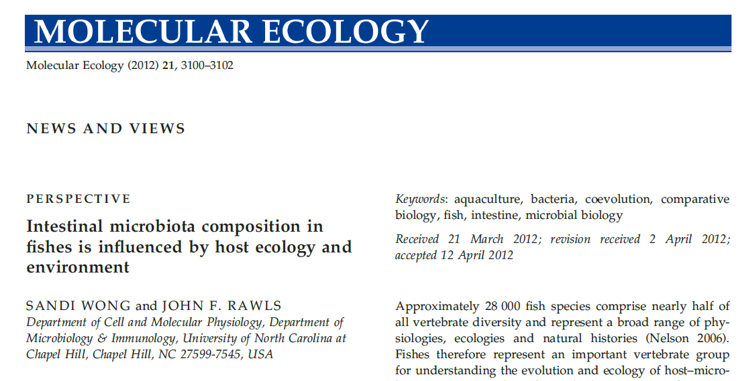
PART 1
Impact Factor: 6.494

Slide 3
Vertebrates
Gut microbiota
digestive tracts
Be colonized by Complex assemblages of micro-organisms

Slide 4
Intense interest point：
1. How gut microbial communities are assembled ?
2. How they impact host fitness ?( Sekirov et al. 2010).
The order of research：
Mammal
Fish

Slide 5
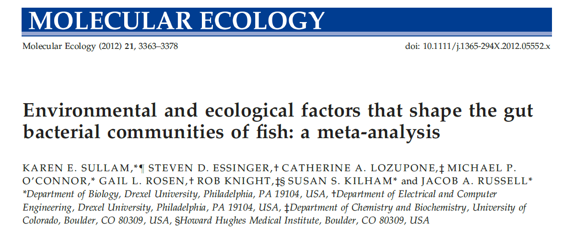
A survey：
Mammals constitute <10% of all vertebrate species, and it remains unclear whether similar associations exist in more diverse and ancient vertebrate lineages such as fish.
In this issue, Sullam et al. (2012) make an important contribution toward identifying factors determining gut microbiota composition in fishes.

Slide 6
The intestines of
different fish species
Experimental flow graph
25 bacterial 16S rRNA
gene sequence libraries
Meta-analysis
Comparison
16S rRNA gene sequence
data sets
Results

Slide 7
Results：
Variation in gut microbiota composition in fishes is strongly correlated with species habitat salinity, trophic level and possibly taxonomy.（comparison within groups ）
Fish gut microbiota compositions are often similar to those of other animals and contain relatively few free-living environmental bacteria.（comparison among groups ）

Slide 8
Suggestion：
The gut microbiota composition of fishes is not a simple reflection of the micro-organisms in their local habitat but may result from host-specific selective pressures within the gut( Bevins & Salzman 2011).
Approximately 28 000 fish species comprise nearly half of all vertebrate diversity and represent a broad range of physiologies, ecologies and natural histories ( Nelson 2006).
Important vertebrate group

Slide 9
The research of the gut microbiota of fishes：
Culture-based approaches
Culture-independent DNA sequence-based approaches
Few studies have compared the intestinal bacterial diversity of multiple species .
( Roeselers et al. 2011)
?
?
Ecological and environmental factors

Slide 10
More fish species?
This article by Sullam et al. (2012) is significant because it presents phylogenetic and statistical meta-analyses of intestinal microbiotas from the largest number of fish species to date.
24 published culture-dependent and culture-independent libraries
18 fish species
Water salinities
Trophic levels
A new library from Trinidadian guppy, Poecilia reticulata

Slide 11
Principal coordinate analysis (PCoA)
Freshwater
Saltwater
Estuarine fish
salinity
Carnivores
Omnivores
Herbivores
host trophic level
fish taxonomy

Slide 12
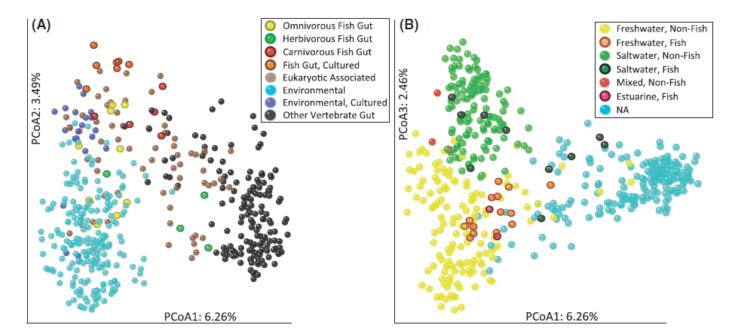
Co-evolution ?
(Sullam et al. 2012)

Slide 13
This is consistent with a previous report showing that colonization of germ-free zebrafish with a Firmicutes phylum-dominant mouse gut microbiota results in enrichment of phylum Proteobacteria, which normally dominates zebrafish intestines (Rawls et al. 2006).
Additionally, in accordance with previous studies noting few differences between animals raised in artificial and natural environments (Ley et al. 2008a; Roeselers et al. 2011).

Slide 14
The analysis detected no significant effects of rearing environment on gut microbiota composition. (Sullam et al. 2012)
Together, these data support several emerging themes in fish gut microbial ecology: microbiota composition is strongly associated with host trophic level, habitat salinity and perhaps taxonomy, and but with relatively little impact of host provenance.

Slide 15
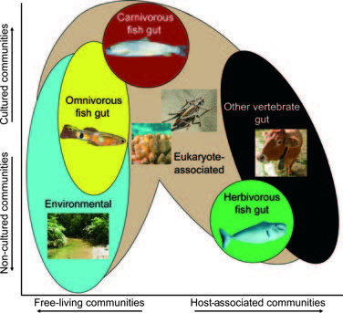
Surprising occurrence:
More than half the OTUs from herbivorous fishes were more closely related to bacteria in mammalian and bird intestines than to bacteria from fish intestines.

Slide 16
guidance
It will be important in the future to include additional freshwater herbivores and fish from taxa, trophic levels and water salinities not included in this study.
Moreover, the potential impact of other environmental parameters (e.g. water depth and temperature, diet composition, food chain dynamics, geographic location), host physiological parameters (e.g. developmental stage, immunity, digestive anatomy and physiology) and the interaction between these factors on gut microbiota composition needs to be evaluated.
This information would provide an essential foundation for exploring the impact of gut microbiota composition and function on the ecology, fitness and evolution of their respective hosts.

Slide 17
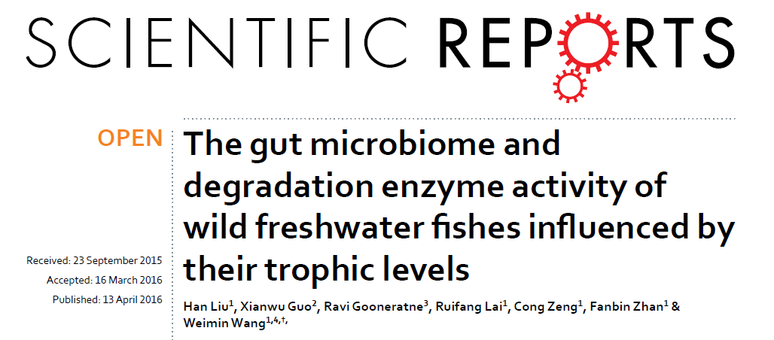
PART 2
Impact Factor: 5.578

Slide 18
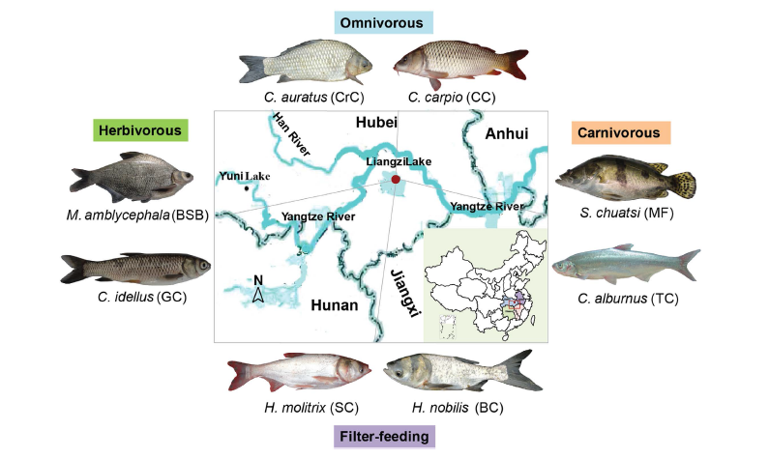
8 fish species
985,000 quality-filtered sequences
24 16S rRNA libraries
翘嘴鲌[bó]
PICRUSt predictions of metagenome function

Slide 19
The approaches to investigate the gut bacterial diversity:
Isolation and cultivation approaches (Under laboratory conditions)
PCR denaturing gradient gel electrophoresis (DGGE)
Terminal restriction fragment length polymorphism (T-RFLP)
Next-generation sequencing of 16S rRNA gene
Single Molecule Real Time (SMRT™) DNA Sequencing
Oxford Nanopore Technologies
……

Slide 20
Some commercially viable fishes:
European sea bass , grass carp , perch , channel catfish and rainbow trout.
Rearing conditions
Fish species with distinct trophic levels from natural environments
Innovative Points of the Research
Herbivorous
Carnivorous
Omnivorous
Filter-feeding
At the same time point
In the same water area
gut content :
cellulase/amylase/trypsin
enzyme activities

Slide 21
Cellulase
No endogenous genes coding cellulose-digesting enzymes were found in the genome of mammals. (Li, R. et al. 2010),but Clostridium group I (Zhu et al. 2011).
Cellulolytic enzyme-producing bacterial community: Aeromonas, Enterobacter, Citrobacter, Bacillus, and Pseudomonas (Ray et al. 2012, Li, H. et al. 2016).

Slide 22
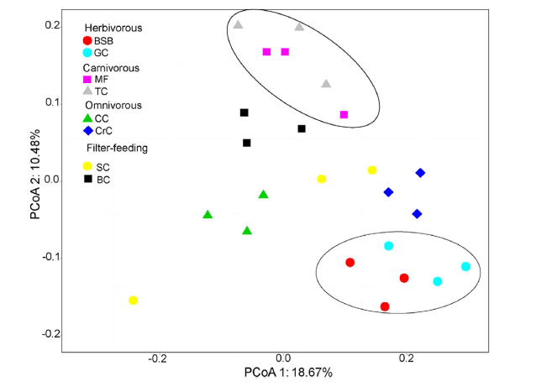

Slide 23
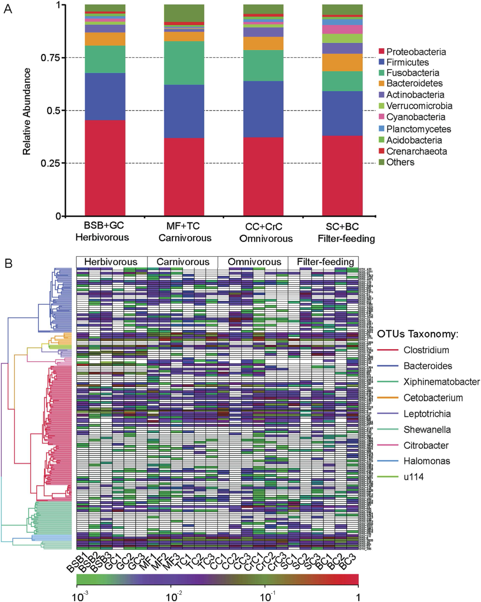
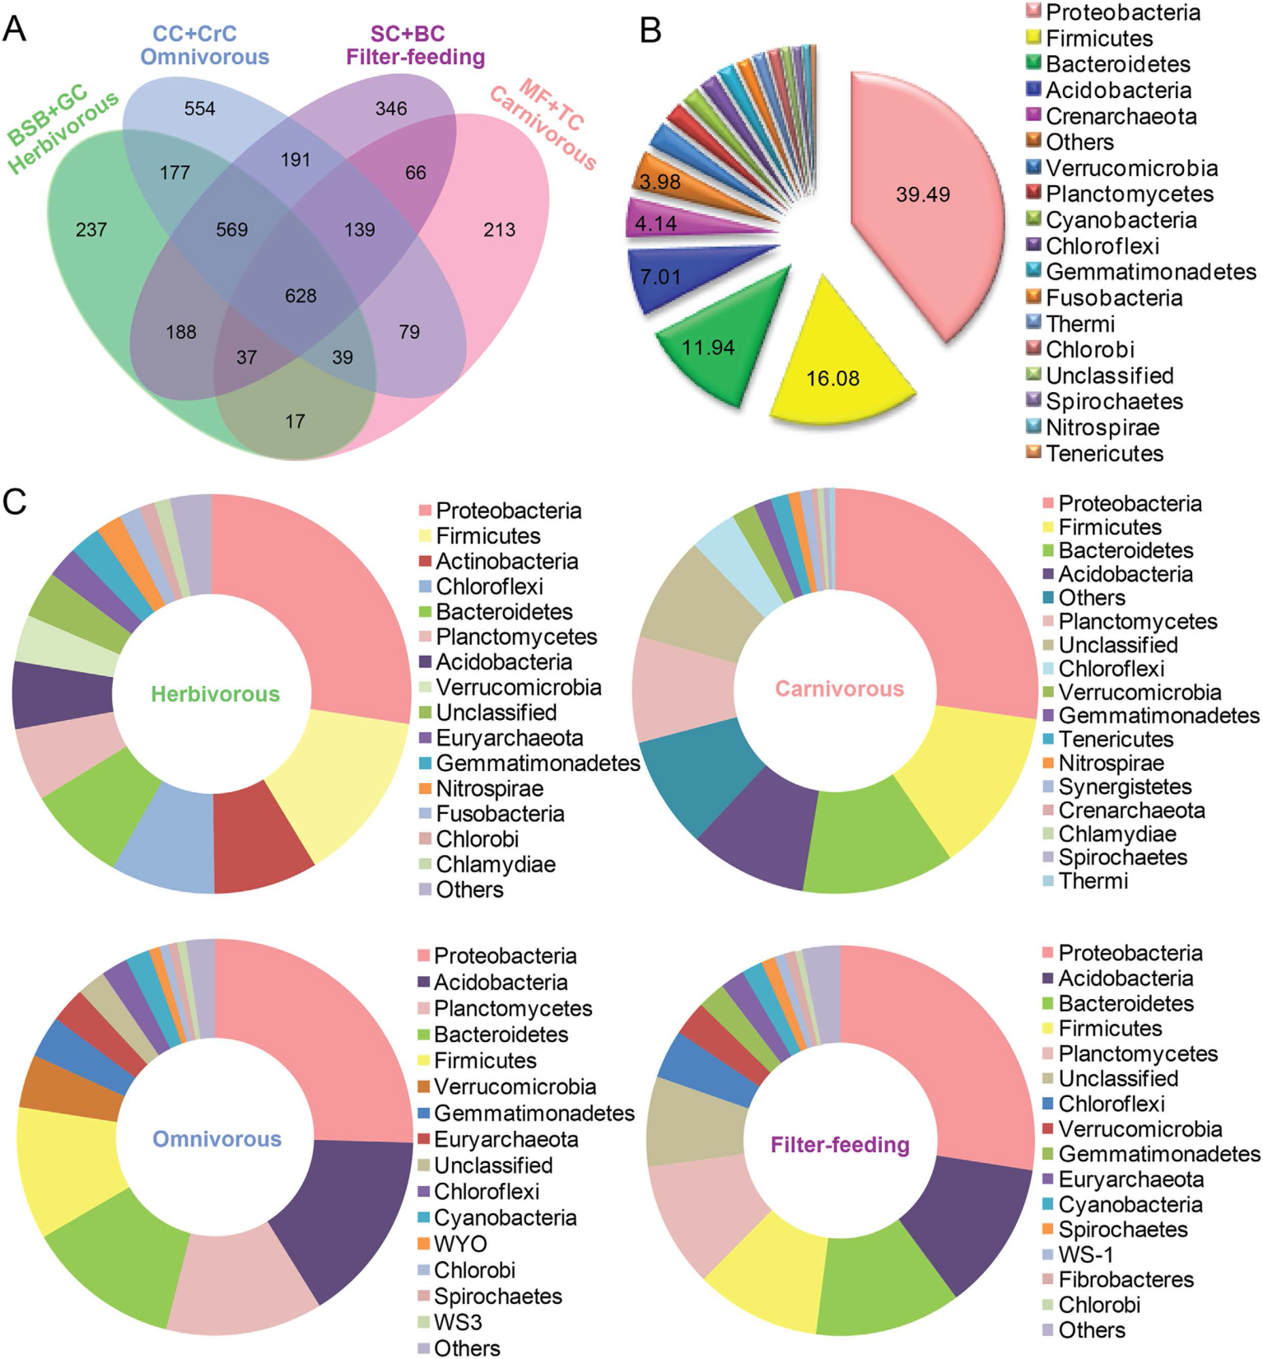

Slide 24
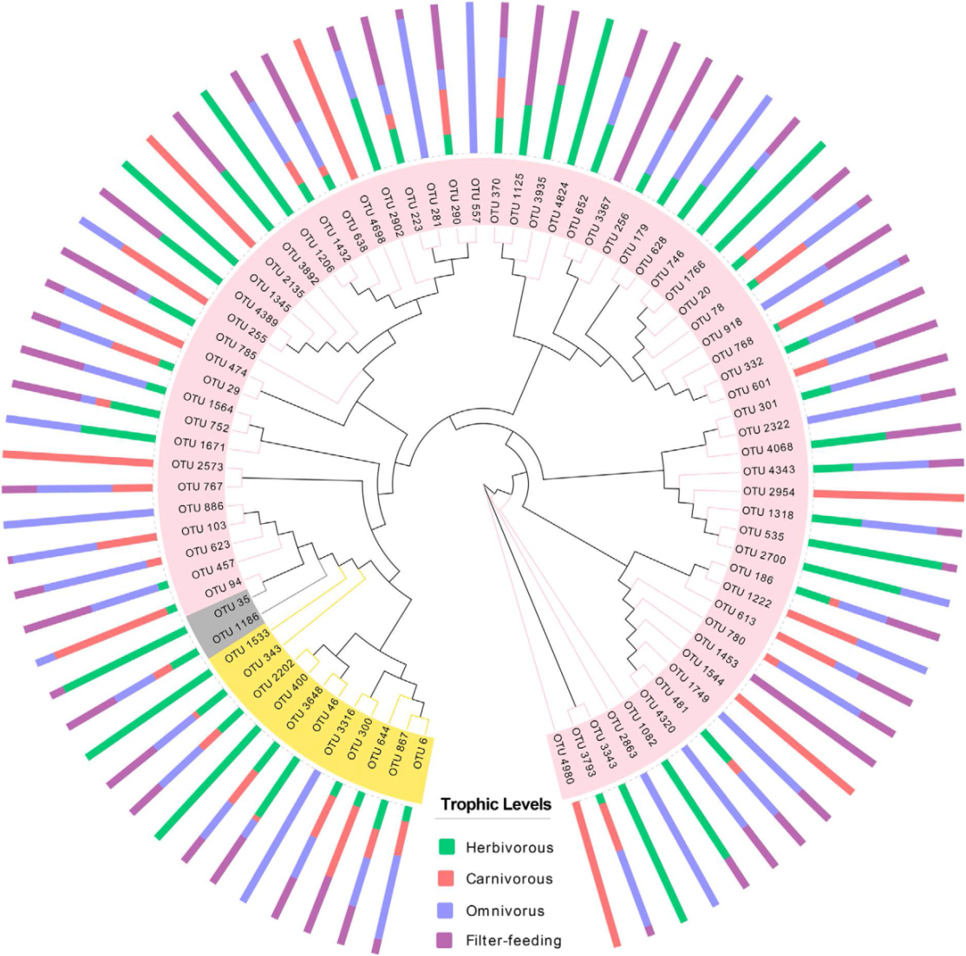
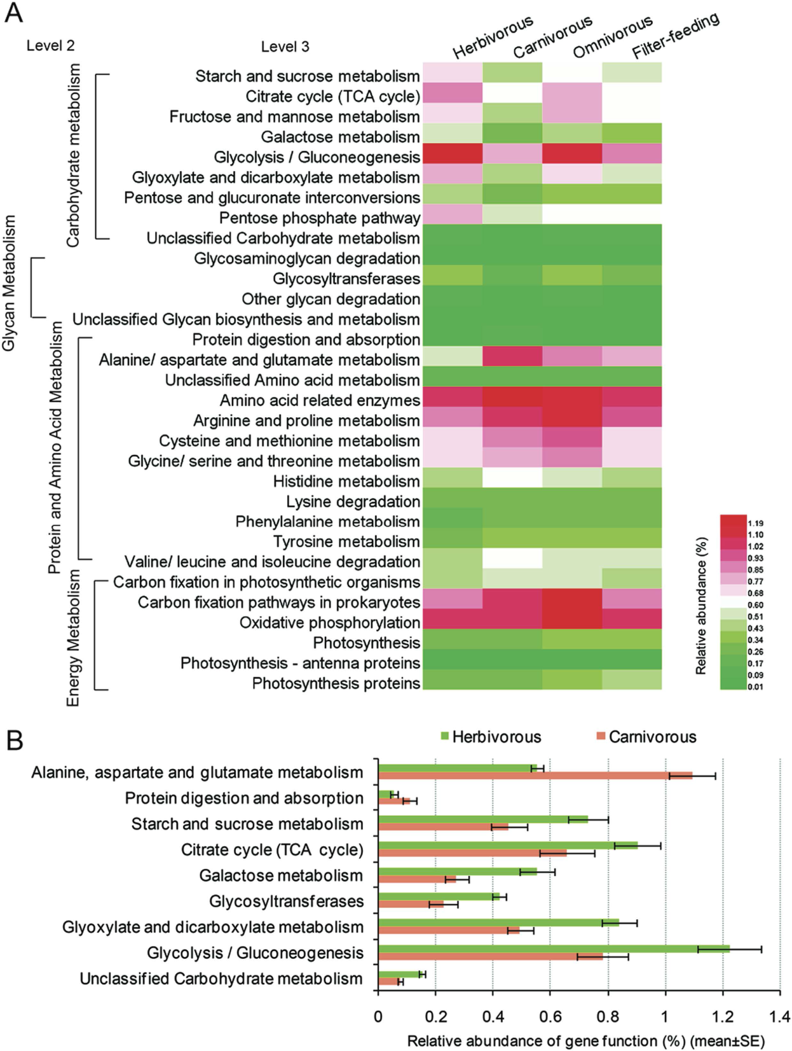
Figure 5. Dendrogram of cellulose-degrading represented OTUs and their host occurrence patterns. Bars show the proportion of fish samples with different trophic levels in which the given OTUs is present. Circles indicate the phylogenetic relationship of 13 kinds of cellulolytic species.
Degree of accuracy gt 85%-90%
Figure 6. Comparison in the relative abundance of PICRUSt-generated functional profile of gut microbiota among four trophic levels. (A) Heat map shows the relative abundance changes in fishes with four trophic levels. (B) Significant differences in gene categories at level 3 (t-test, P < 0.05) between the herbivorous and the carnivorous.
PICRUSt: Phylogenetic Investigation of Communities by Reconstruction of Unobserved States
Notes:
三羧酸循环（tricarboxylic acid cycle）是需氧生物体内普遍存在的代谢途径，分布在线粒体。因为在这个循环中几个主要的中间代谢物是含有三个羧基的柠檬酸，所以叫做三羧酸循环，又称为柠檬酸循环或者是TCA循环或TCA；或者以发现者Hans Adolf Krebs（英1953年获得诺贝尔生理学或医学奖）的姓名命名为Krebs循环。三羧酸循环是三大营养素（糖类、脂类、氨基酸）的最终代谢通路，又是糖类、脂类、氨基酸代谢联系的枢纽。
1．三大营养素的最终代谢通路
糖、脂肪和蛋白质在分解代谢过程都先生成乙酰辅酶A，乙酰辅酶A与草酰乙酸结合进入三羧酸循环而彻底氧化。所以三羧酸循环是糖、脂肪和蛋白质分解的共同通路。
2．糖、脂肪和氨基酸代谢的联系通路
三羧酸循环另一重要功能是为其他合成代谢提供小分子前体。α-酮戊二酸和草酰乙酸分别是合成谷氨酸和天冬氨酸的前体；草酰乙酸先转变成丙酮酸再合成丙氨酸；许多氨基酸通过草酰乙酸可异生成糖。所以三羧酸循环是糖、脂肪酸(不能异生成糖)和某些氨基酸相互转变的代谢枢纽。
Phylogenetic Investigation of Communities by Reconstruction of Unobserved States

Slide 25
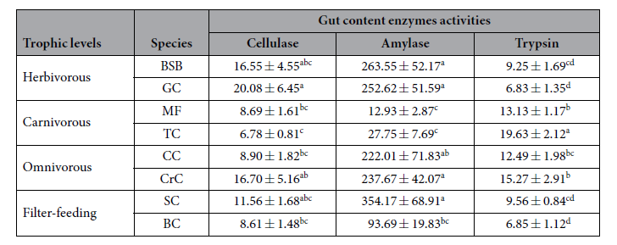
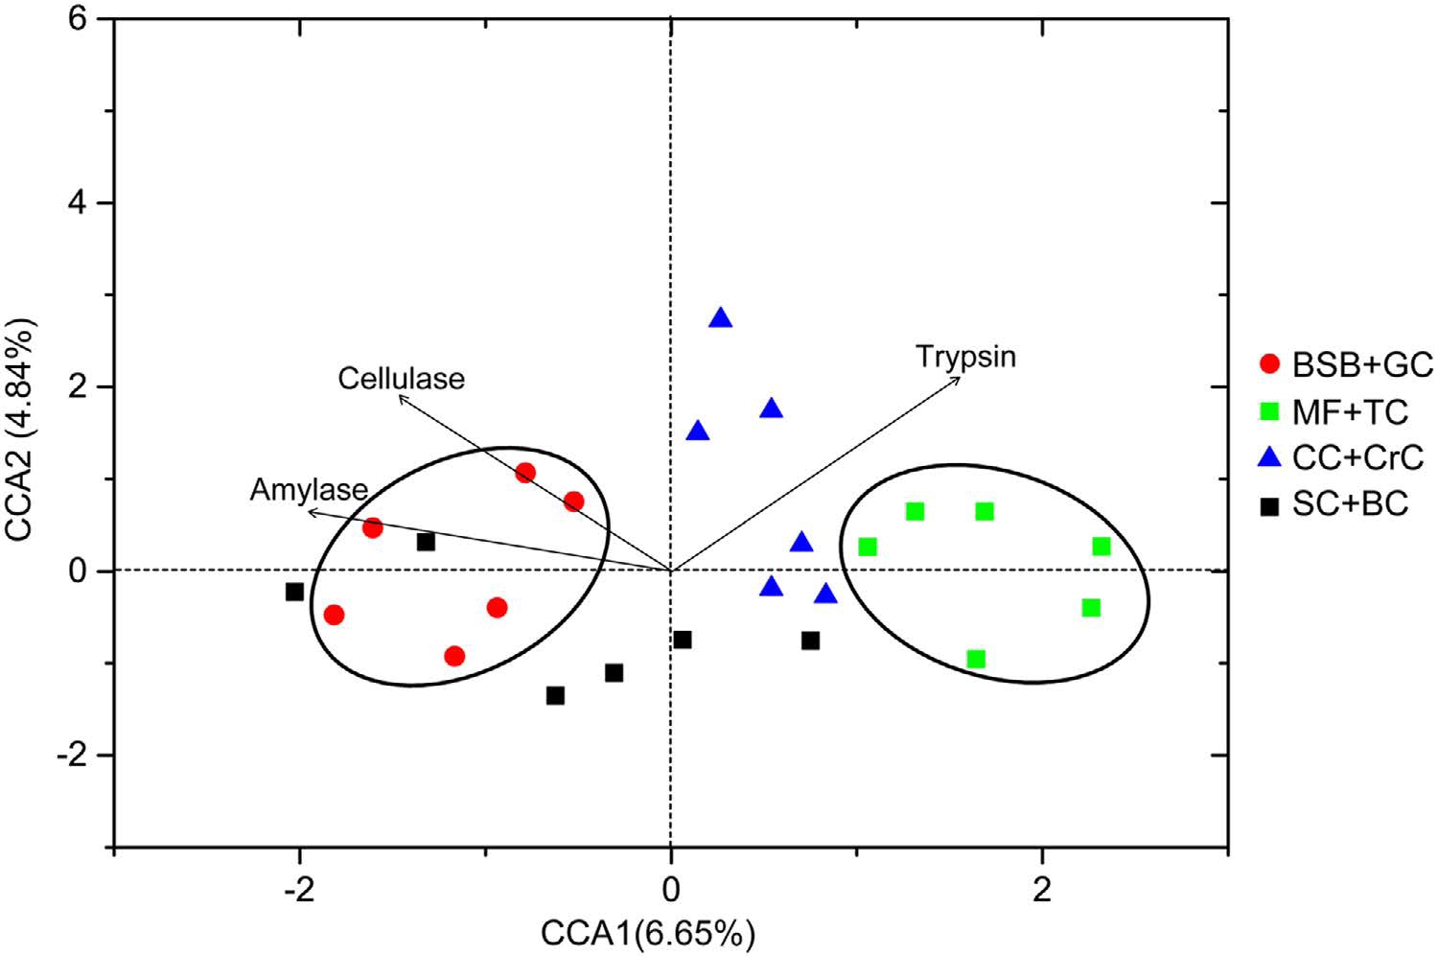
Table 2. Fish gut content enzymes activities (U/mg protein). The means (mean ± SE) with different letters in each enzyme indicate significant differences. ANOVA was followed by Tukey’s test, P < 0.05.
Figure 7. Canonical correspondence analysis (CCA) showing the correlation between the gut microbial compositions of eight fish species and their enzyme activities.

Slide 26
Sample collection:
Prior to dissection, fishes were euthanized with an overdose of tricaine methanesulfonate (dissolved in water). All procedures for handling and euthanasia of wild freshwater fish species were approved by institution animal care. To help eliminate transient bacteria, the whole intestinal tract of individual fish was dissected with sterile instruments and washed in 70% ethanol and sterile water. Then the gut content from the midgut region to the hindgut region were squeezed out and mixed thoroughly, and then collected into sterile tubes and immediately stored at liquid nitrogen.

Slide 27
DNA extraction, amplification and sequencing :
200 mg sample
Homogenized using a three-minute bead beating procedure at 30 Hz
QIAamp DNA Stool Mini Kit (Qiagen, Valencia, USA)
Electrophoresis in 1% agarose gel with Tris-acetate-EDTA (TAE) buffer
NanoDrop ND-2000 spectrophotometer (Thermo Scientific)
Illumina MiSeq sequencing platform
V4 hypervariable region (515F and 806 R) of the 16S rRNA gene
The reverse primer contained a 6-bp error-correcting barcode
Novogene Bioinformatics Technology

Slide 28
Taxonomic analyses of sequenced reads.
Analysis of Enzyme activities.
200 mg sample、2mL 0.1 M phosphate buffer on ice (PBS, pH 6.8, 1:20 w/v)
Hand-held glass homogenizer
Be centrifuged at 12,000 × g for 20 min at 4 °C
The supernatant was divided into four Eppendorf tubes and then stored at − 40 °C
All enzymatic assays were conducted within 3 days after extraction.
……

Slide 29
The Revelations to Me
What can I do now?
Which I need to do now?
How to sample and handling the fish gut?
How to analysis the data sets?
How to create the connection between the different results?
……

Slide 30
THANKS!
2016-05-21

