Slide 1
Article
Organ-Specific and Size-Dependent Ag Nanoparticle Toxicity in Gills and Intestines of Adult Zebrafish
Wenli Guo
Olivia J. Osborne, Sijie Lin, Chong Hyun Chang et al. ACS Nano. 2015

Slide 2
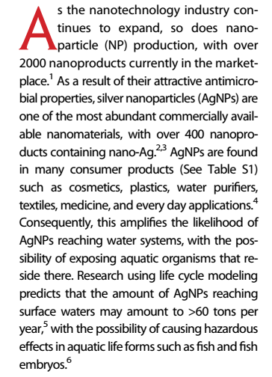
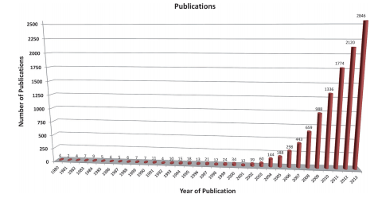

Slide 3
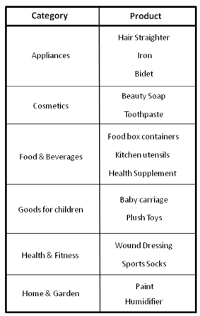
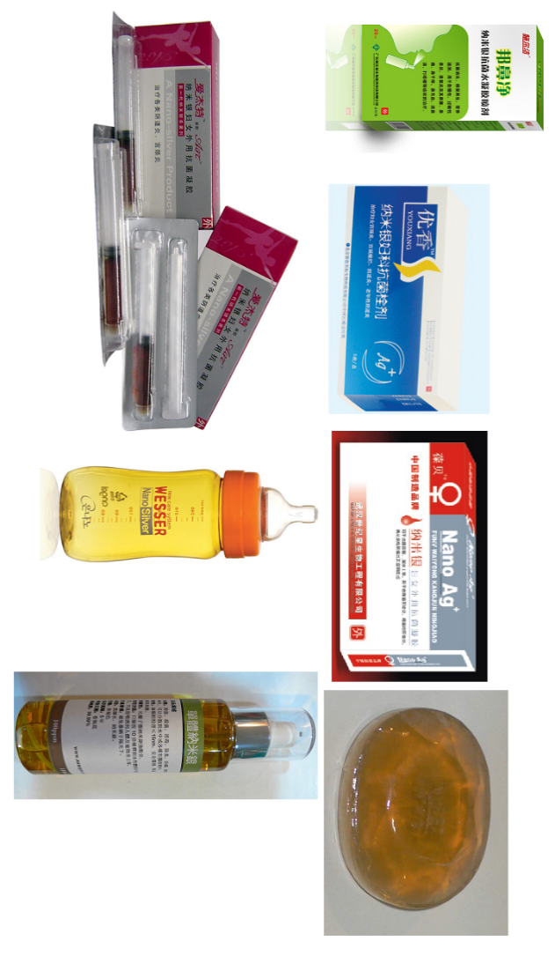
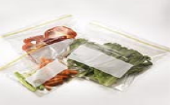


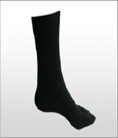

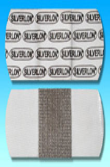

Slide 4
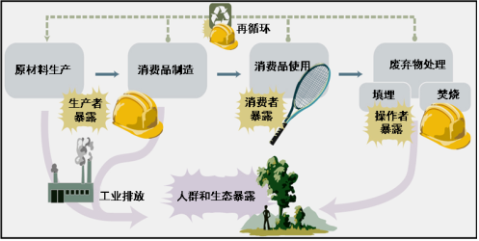
人工纳米材料的环境暴露风险和人类的健康风险示意图

Slide 5
Known:
Smaller AgNPs exert more hazardous effects in zebrafish embryos and induce more intense inflammation and oxidative stress in the lungs of rodents than larger particles.
Unknown:
Whether different particle sizes could impact known target organs for hazardous substances in fish, namely, the gills and intestines?
whether size-dependent variances are differently reflected in the target organs?

Slide 6
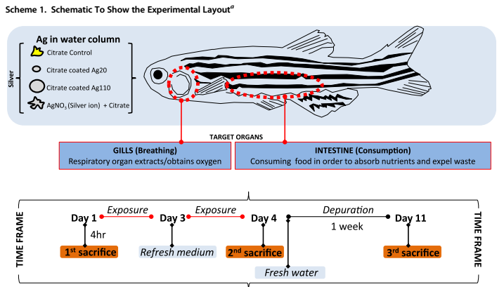

Slide 7
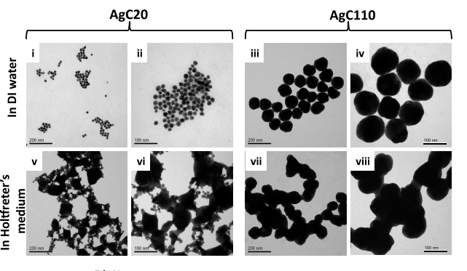
Results
Physicochemical Characterizations of the AgNPs

Slide 8
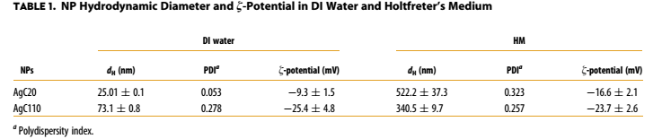
Results
Physicochemical Characterizations of the AgNPs

Slide 9
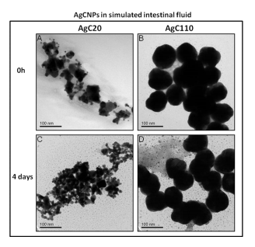
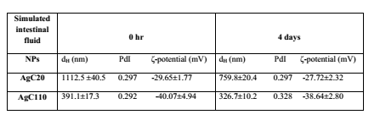
Results
Physicochemical Characterizations of the AgNPs

Slide 10
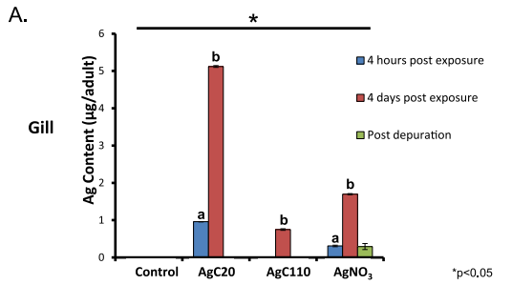
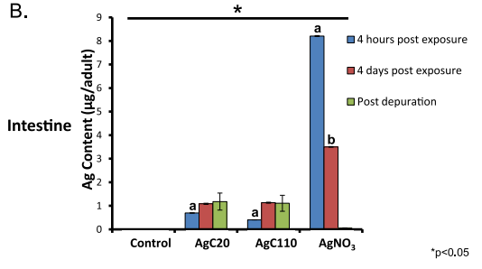
Results
Quantification of the Ag Content of the Gills and Intestines reveals Size-Dependent Differences.
Figure 2. Toxicokinetic profiles of AgC20 and AgC110 in gills and intestines at 4 h postexposure (4hpe) (blue bars), 4 days postexposure (4dpe) (red bars), and 4 days þ 7 days depuration (green bars).

Slide 11
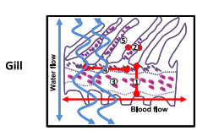
Results
Histopathological Features of Gill and Intestine by Nano-Ag and Ionic-Ag.

Slide 12
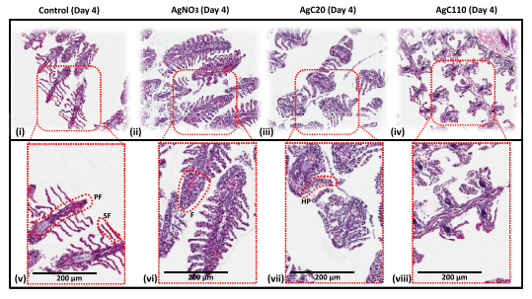
Results
Histopathological Features of Gill and Intestine by Nano-Ag and Ionic-Ag.

Slide 13
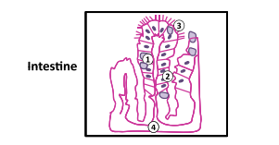
Results
Histopathological Features of Gill and Intestine by Nano-Ag and Ionic-Ag.

Slide 14
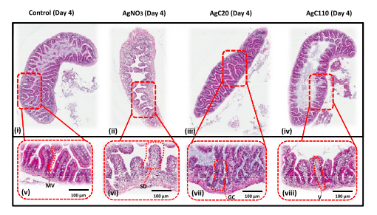
Results
Histopathological Features of Gill and Intestine by Nano-Ag and Ionic-Ag.

Slide 15
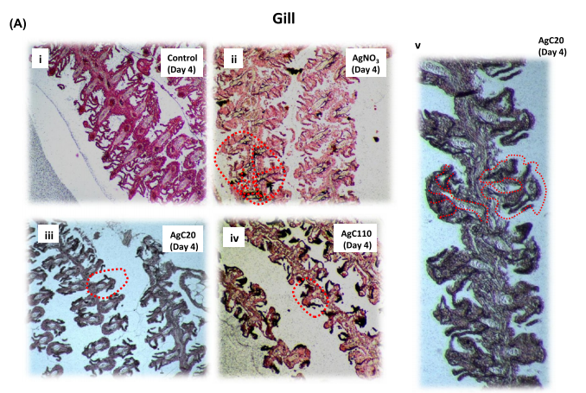
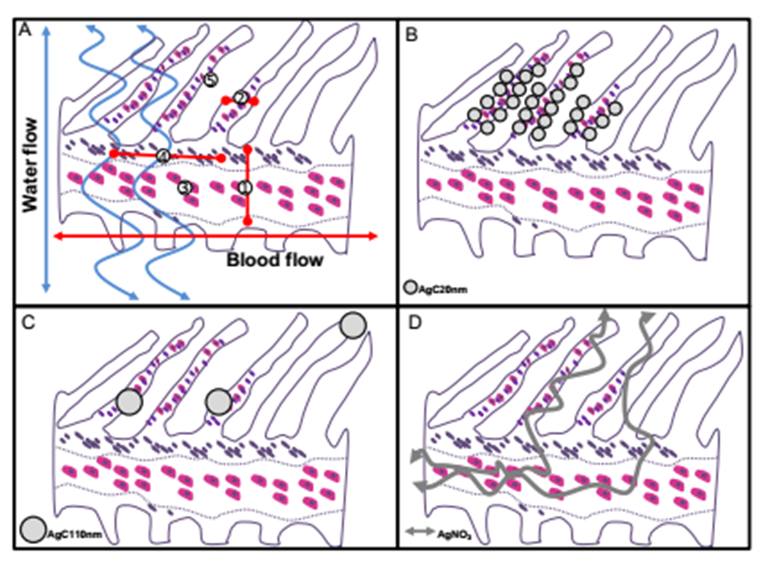
Results
Ag Staining of Gill Tissue Reveals Differences in the Localization of Particulate vs Ionic

Slide 16
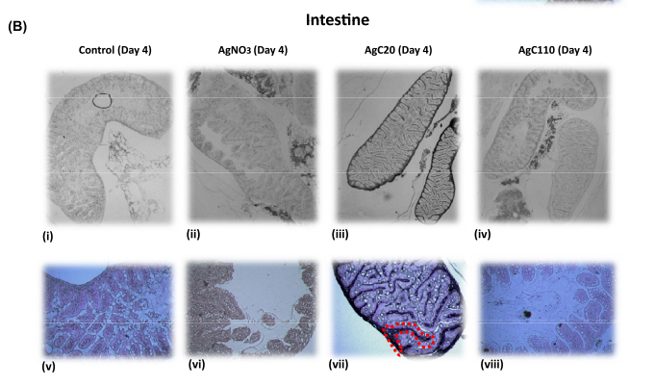
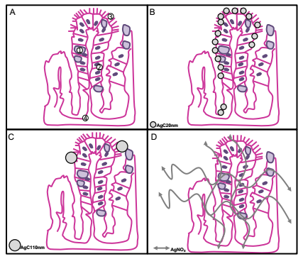
Results
Ag Staining of Intestinal Tissue Reveals Differences in the Localization of Particulate vs Ionic

Slide 17
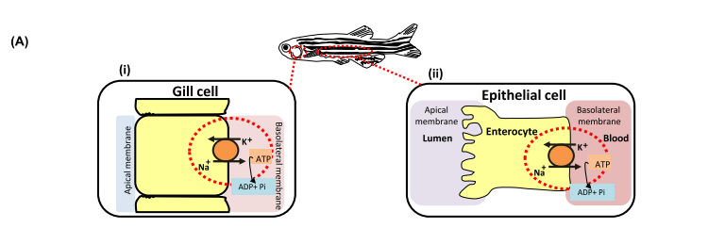
Results
Na⁺/K⁺ ATPase Immunohistochemistry Staining and Activity Demonstrate Size-Dependent Effects of Nano-Ag

Slide 18
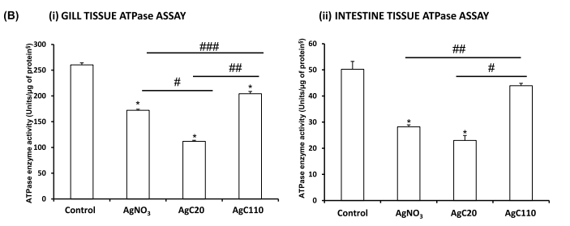
Results
Na⁺/K⁺ ATPase Immunohistochemistry Staining and Activity Demonstrate Size-Dependent Effects of Nano-Ag

Slide 19
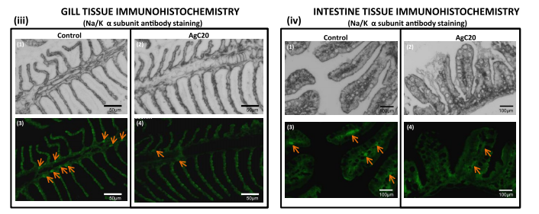
Results
Na⁺/K⁺ ATPase Immunohistochemistry Staining and Activity Demonstrate Size-Dependent Effects of Nano-Ag

Slide 20
思路
方案
细节
描述

Slide 21
Thank you

