Slide 1

读书报告
报告人：秦超彬
2016年4月9日

Slide 2
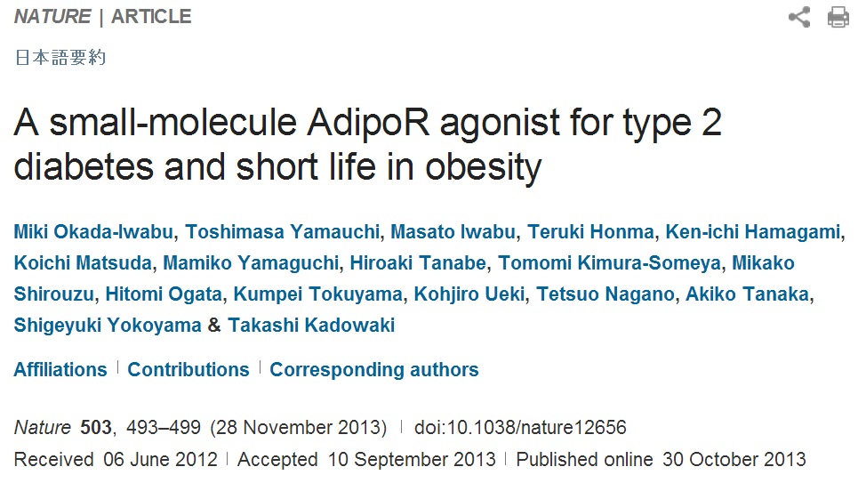

Slide 3

1
Introduction
Obesity
morbidity
and
mortality
Insulin
resistance
Type 2 diabetes
Cardiovascular diseases
Insulin resistance and type 2diabetes: satisfactory treatment modalities remain limited.
Notes:
发病率和死亡率

Slide 4





1
Introduction
Adiponectin is an antidiabetic and antiatherogenic adipokine.
Decreased in obesity, insulin resistance
and type 2 diabetes
Replenishment of adiponectin:
ameliorate insulin resistance, glucose intolerance
Insulin sensitizing effect:
increase fatty acid oxidation
AMPK: AMP activated protein kinase
PPARα: peroxisome proliferator activated receptor α
Notes:
antiatherogenic抗动脉弱样硬化, PPAR过氧化物酶体增殖物激活受体

Slide 5
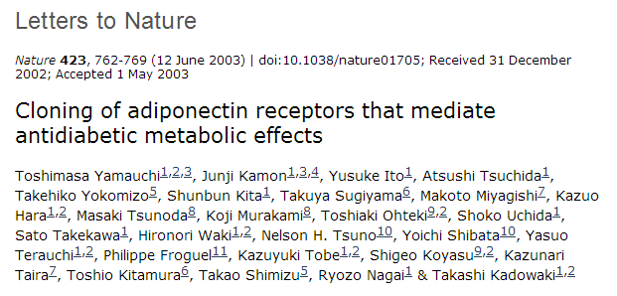
1
Introduction
Skeletal muscle
Liver
AdipoR1 and AdipoR2 serve as the major receptors for adiponectin, with AdipoR1 activating the AMPK pathways and AdipoR2 activating the PPARα pathways.
Predominantly AdipoR1
Activates AMPK and PPARγ coactivator PGC-1α as well as Ca²⁺ signalling pathways.
Activated by exercise
AdipoR1 and AdipoR2
Regulation of glucose and lipid metabolism.
Exercise:
Beneficial effects on obesity related diseases such as type 2 diabetes
Contribute to healthy longevity
Notes:
过氧化物酶体增殖活化受体γ共激活因子-1α（PGC-1α），受到Ca2+依赖通路激活，如钙调蛋白激酶（CaMK）等

Slide 6
1
Introduction
Here we report the discovery of an orally active synthetic small molecule that binds to and activates both AdipoR1 and AdipoR2, ameliorates insulin resistance and type 2 diabetes, and prolongs the shortened life span of db/db mice.

Slide 7
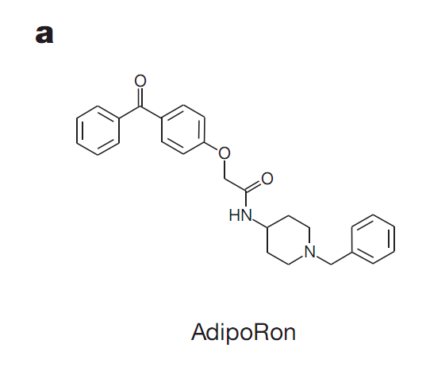
2.1 Identification of small molecule agonists of AdipoR
2
Results
Screened a number of small molecules in the chemical library at Open Innovation Center for Drug Discovery, TheUniversity of Tokyo (东京大学药物发现开放创新中心化学库).
Activate AMPK
The dependency of stimulated AMPK on AdipoR in C2C12 myotubes.

Slide 8
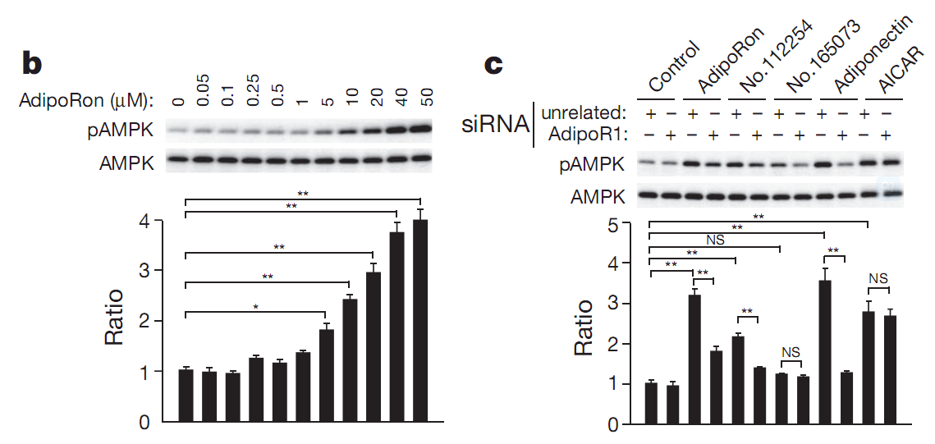
2.1 Identification of small molecule agonists of AdipoR
2
Results
C2C12 myotubes: AdipoRon increase the phosphorylation of AMPKα; Suppression of AdipoR1 by specific siRNA greatly reduced the increase in AMPK phosphorylation induced by AdipoRon,indicating that AdipoRon increased AMPK phosphorylation via AdipoR1.
Notes:
AICAR是AMP类似物,可通透细胞膜激活AMPK

Slide 9
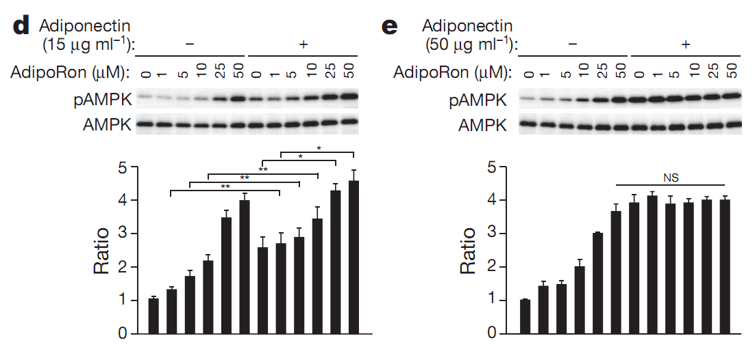
2.1 Identification of small molecule agonists of AdipoR
2
Results
AdipoRon replenished AMPKphosphorylation stimulated by adiponectin.
Notes:
在次极大浓度脂联素存在与否的情况下，随着AdipoRon浓度的增加，AMPK磷酸化水平逐渐升高。而在最高浓度脂联素存在的情况下，AdipoRon则不能够促进AMPK的磷酸化。说明，AdipRon能够起到补充脂联素的作用，激活AMPK。

Slide 10
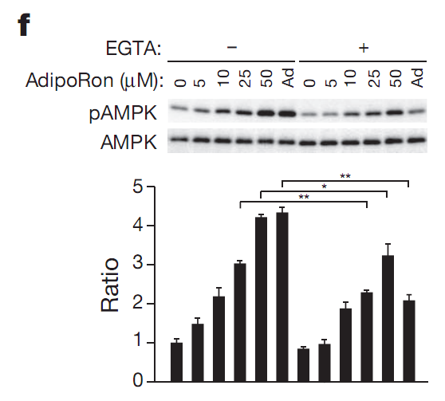
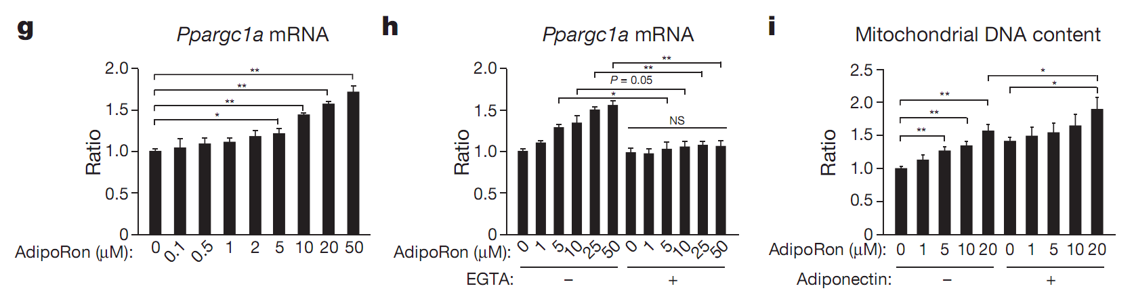
2.1 Identification of small molecule agonists of AdipoR
2
Results
AdipoRon increased PGC-1α expression which is dependent on Ca²⁺ signalling.
Notes:
f，在C2C12细胞中，EGTA能够部分抑制AdipoRon对AMPK的激活，说明胞外游离钙离子是必须的，与脂联素的作用一致。AMPK上游激酶CaMKK（钙调蛋白依赖性蛋白激酶激酶)、LKB1（Liver Kinase B1）
g-i，AdipoRon能够以剂量依存方式促进PGC-1α 表达，增加线粒体DNA的含量，添加EDTA后AdipoRo促进PGC-1α表达的效应消失 。与脂联素的作用一致。
EGTA，乙二醇双(2-氨基乙基醚)四乙酸

Slide 11
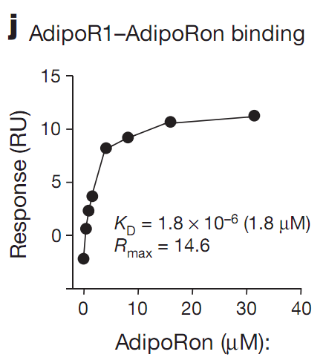
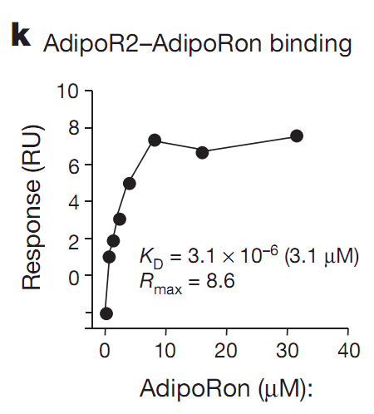
2.1 Identification of small molecule agonists of AdipoR
2
Results
AdipoRon bound to both AdipoR1 and AdipoR2
Notes:
表面等离子共振Surface plasmon resonance (SPR) ，先将一种靶分子键合在生物传感器表面，再将含有另一种能与靶分子产生相互作用的分析物溶液注入并流经生物传感器表面。生物分子间的结合引起生物传感器表面质量的增加，导致折射指数按同样的比例增强，生物分子间反应的变化即被观察到。这种反应用反应单位（RU）来衡量：1 RU = 1pg 蛋白/mm2 = 1 x 10-6 RIU（折射指数单位）。Kd等于一半的受体被配体结合时配体的浓度

Slide 12
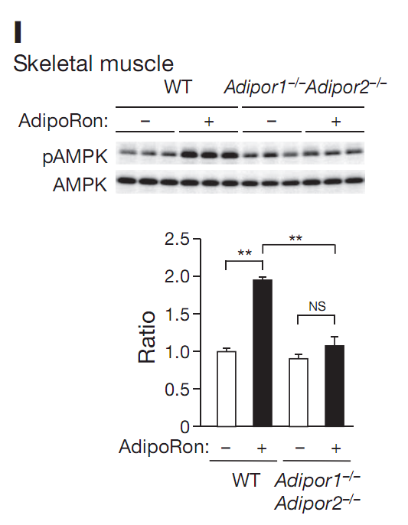
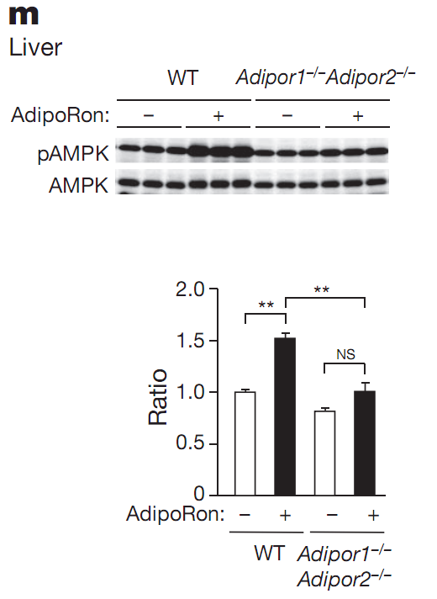
2.1 Identification of small molecule agonists of AdipoR
2
Results
Intravenous injection of AdipoRon (50mg/kg bodyweight)
AdipoRon could activate AMPK in skeletal muscle and liver via AdipoR1 and AdipoR2
Notes:
腹腔注射AdipoRon则能够促进野生小鼠骨骼肌和肝脏AMPK磷酸化水平，AdipoR1和AdipoR2双敲除后，则无此作用。说明AdipoRon在骨骼肌和肝脏中能够通过与脂联素受体结合，激活AMPK。

Slide 13
Summary for part 2.1
AdipoRon 促进AMPK磷酸化，敲除AdipoR1后次效应消失
AdipRon能够起到补充脂联素的作用，激活AMPK
Identification of small molecule agonists of AdipoR
与脂联素相同，AdipoRon依赖于Ca²⁺ 促进PGC-1α表达
Binding assay by surface plasmon resonance
AdipoR敲除前后，静脉注射AdipoRon，肝脏和骨骼肌AMPK磷酸化

Slide 14
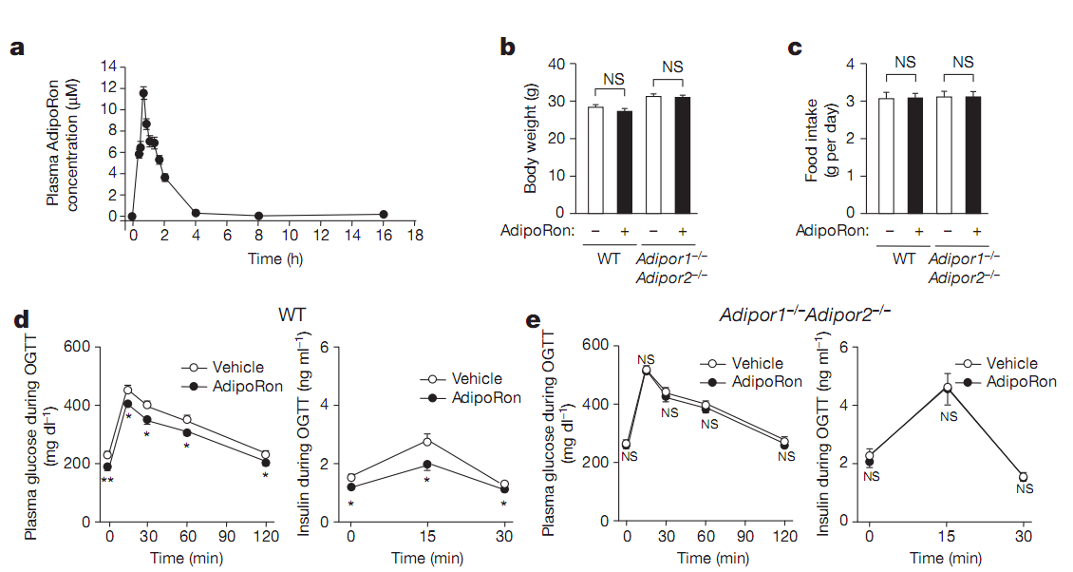
2.2 AdipoRon ameliorates diabetes via AdipoR
2
Results
Orally administered AdipoRon (50mg/kg body weight) for 10d.
Had no affect on bodyweight and foodintake in mice on a high-fat diet, but reduced fasting plasma glucose and insulin levels.
Notes:
口服AdipoRon，血浆最大浓度为11.8uM。高脂饲喂建立肥胖小鼠模型，口服AdipoRon，对体重和摄食没有影响。但在葡萄糖耐量实验中能够降低血糖和血浆胰岛素水平，敲除AdipoR后，此效应消失。

Slide 15
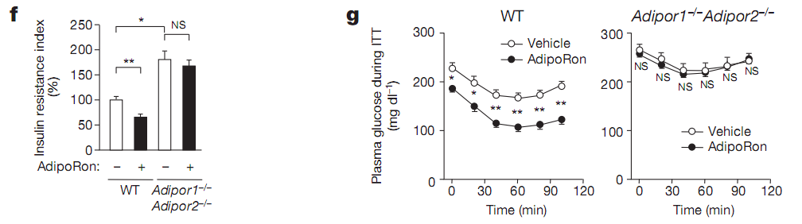
2.2 AdipoRon ameliorates diabetes via AdipoR
2
Results
Insulin resistance index and glucose-lowering effect of exogenous insulin
Notes:
高脂饲喂产生的肥胖小鼠，口服AdipoRon，胰岛素抵抗指数下降，胰岛素降血糖效应更加明显。敲除AdipoR后，这些效应消失。说明，AdipoRon具有增强机体对胰岛素敏感性的作用。Insulin resistance index ：空腹血糖水平（FPG，mmol/L）×空腹胰岛素水平（FINS，mIU/L）/22.5

Slide 16
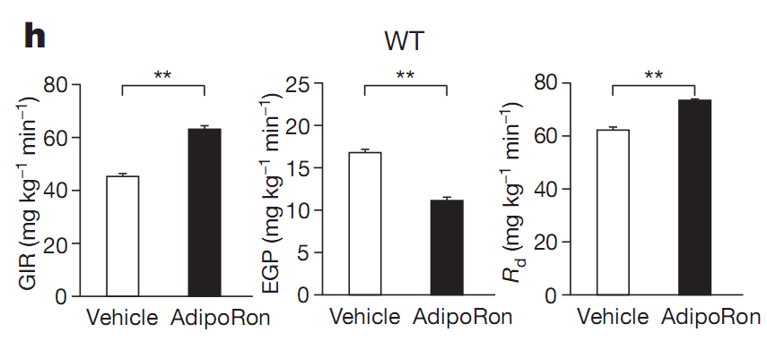
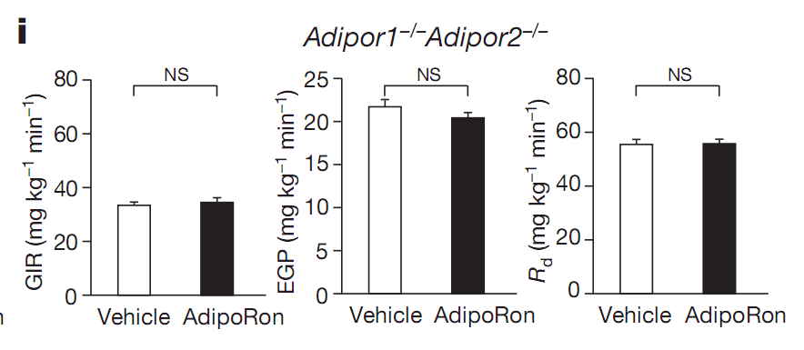
2.2 AdipoRon ameliorates diabetes via AdipoR
2
Results
Hyperinsulinaemic euglycaemic clamps in mice on a high-fat diet after 10days of treatment.
The glucose infusion rate increased, the endogenous glucose production was suppressed, and the glucose disposal rate was increased.
None of these parameters was improved on
AdipoRon treatment in Adipor1^{-/-} Adipor2^{-/-} double knockout mice.
Notes:
高胰岛素-正常血糖钳夹实验，用于评估外周组织对胰岛素的敏感性。通过外周静脉灌注的方法，使受试者血清胰岛素水平上升到约100muU/ml，并维持在这一水平。给予受试者葡萄糖的灌注，且使得血糖浓度维持在正常水平。通过检测葡萄糖的灌注率，评价葡萄糖代谢率和胰岛素敏感性。高脂饲喂肥胖小鼠口服AdipoRon 10d后，葡萄糖灌注率明显提高，内源性葡萄糖的产生明显降低，葡萄糖代谢速率明显加快。敲除AdipoR后，这些效应消失。也说明，AdipoRon具有增强胰岛素敏感性的作用。

Slide 17
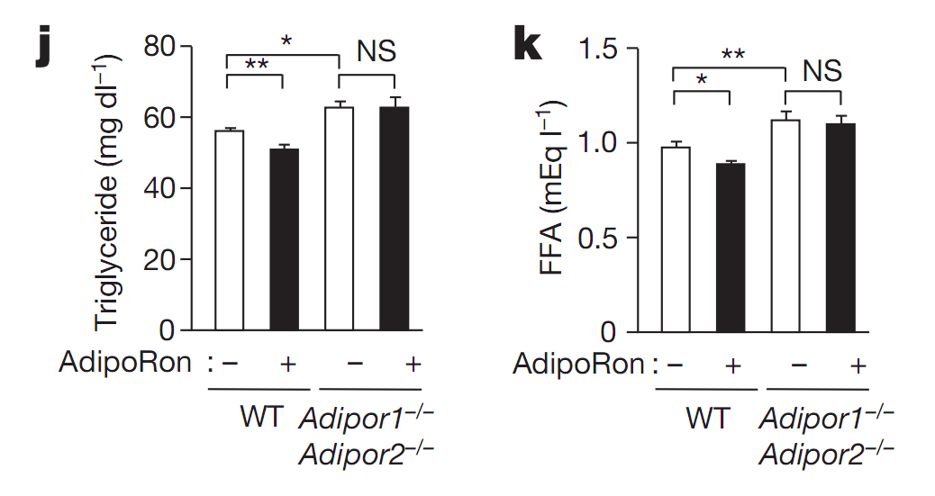
2.2 AdipoRon ameliorates diabetes via AdipoR
2
Results
Treatment with AdipoRon for 10d reduced plasma concentrations of TG and FFA in wild-type mice fed a high-fat diet, these effects were not observed in Adipor1^{-/-} Adipor2^{-/-} double knockout mice.
Notes:
AdipoRon对脂代谢的影响。高脂饲喂肥胖小鼠口服AdipoRon 10d后，血清中TG和FFA含量下降，敲除AdipoR后，AdipoRon的这些效应消失。

Slide 18
Summary for part 2.2
口服AdipoRon后，药物动力学
AdipoR敲除前后，口服AdipoRon对高脂饲喂肥胖小鼠体重、摄食、血糖、胰岛素抵抗指数、胰岛素降血糖效应的影响。
AdipoRon ameliorates diabetes via AdipoR
高胰岛素-正常血糖钳夹实验：AdipoR敲除前后，口服AdipoRon对葡萄糖灌注率，内源性葡萄糖的产生，葡萄糖代谢速率的影响。
口服AdipoRon对脂代谢的影响： AdipoR敲除前后，血清TG和FFA

Slide 19
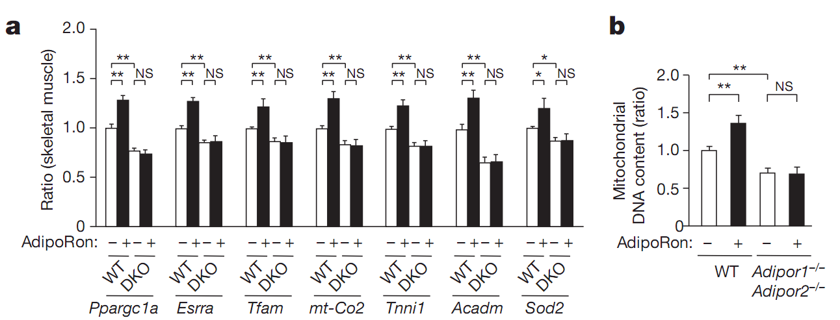
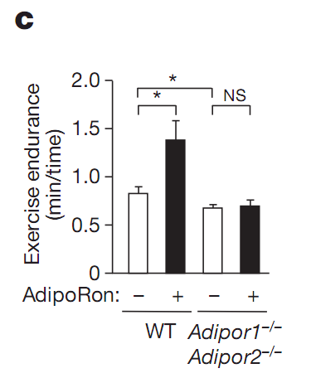
2.3 Skeletal muscle：AdipoRon activates AdipoR1–AMPK–PGC-1α pathways
2
Results
In skeletal muscle, AdipoRon increased the expression of genes involved in mitochondrial biogenesis(Ppargc1a
, Esrra),mitochondrial DNA replication/translation (Tfam), oxidative phosphorylation (mt-Co2), and increased mitochondrial DNA content, increased exercise endurance. These effects were completely obliterated in Adipor1^{-/-} Adipor2^{-/-} double knockout mice.
Notes:
口服AdipoRon对肌肉PGC-1α 表达的影响，以及对其靶基因、线粒体、运动耐力的影响

Slide 20
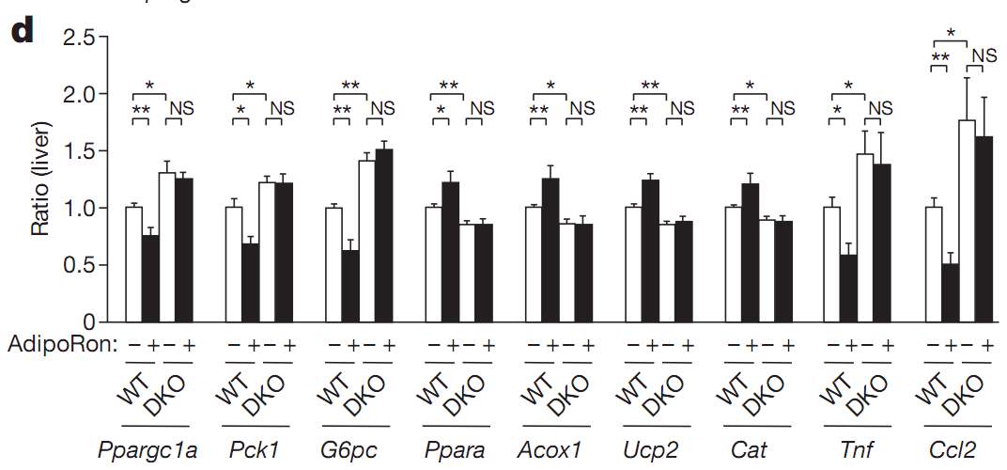
2.4 Liver: AdipoRon also activates AdipoR2–PPARα pathways
2
Results
AdipoRon significantly decreased the expression of Ppargc1a, Pck1 and G6pc in the liver.
--- Activation of AdipoR1–AMPK pathway
AdipoRon increased the expression levels of the gene encoding PPARα itself (Ppara) and its target genes.
Activation of AdipoR2–PPARα pathway

Slide 21
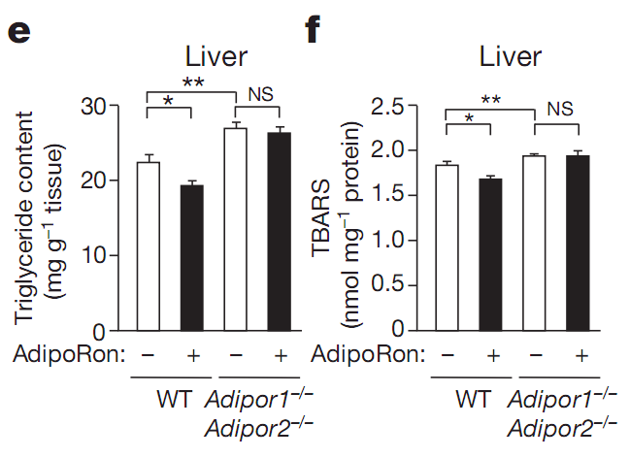
2.4 Liver: AdipoRon also activates AdipoR2–PPARα pathways
2
Results
AdipoRon significantly reduced triglyceride content and oxidative stress
Notes:
肝脏中，AdipoRon能够降低TG含量、抑制氧化应激。

Slide 22
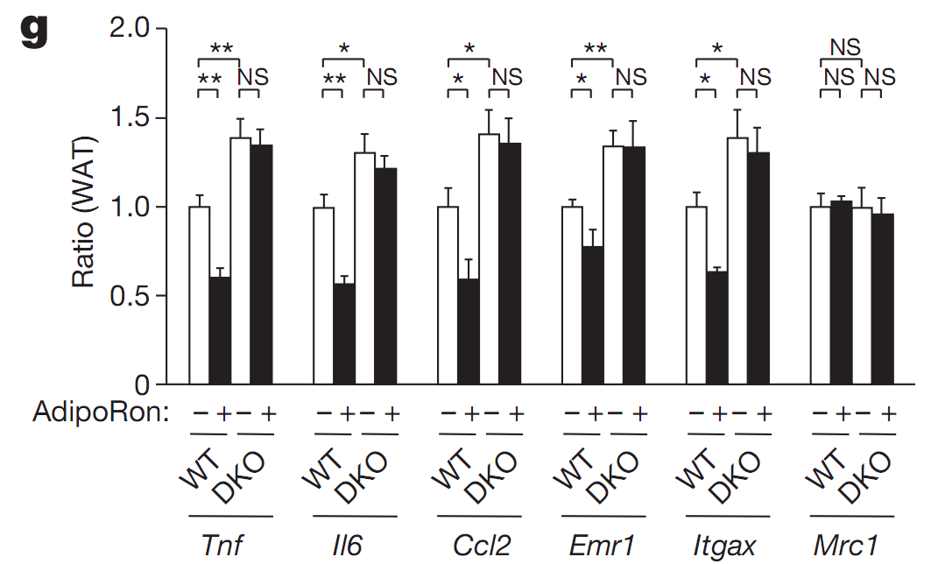
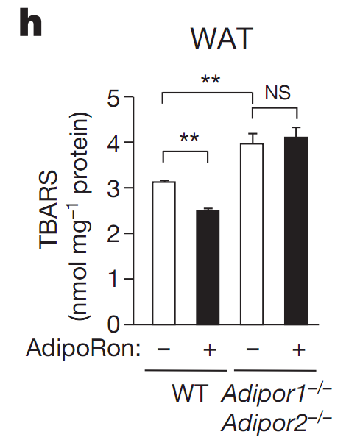
2.5 WAT： AdipoRon decreases inflammation
2
Results
AdipoRon reduced the expression levels of genes encoding proinflammatory cytokines in the white adipose tissue.
AdipoRon reduced TBARS and reduced levels of macrophage markers suchas F4/80(Emr1), and markers for classically activated M1 macrophages such as CD11c (Itgax), but not the markers for the alternatively activated M2 macrophages suchas CD206(Mrc1)
Notes:
白色脂肪组织中，AdipoRon抑制炎症因子基因的表达，抑制巨噬细胞Marker、M1型即经典活化巨噬细胞的Marker，但对M2型即替代性活化的巨噬细胞的Marker没有影响。此外，它还能抑制WAT的氧化应激。BARS检测脂质过氧化。

Slide 23
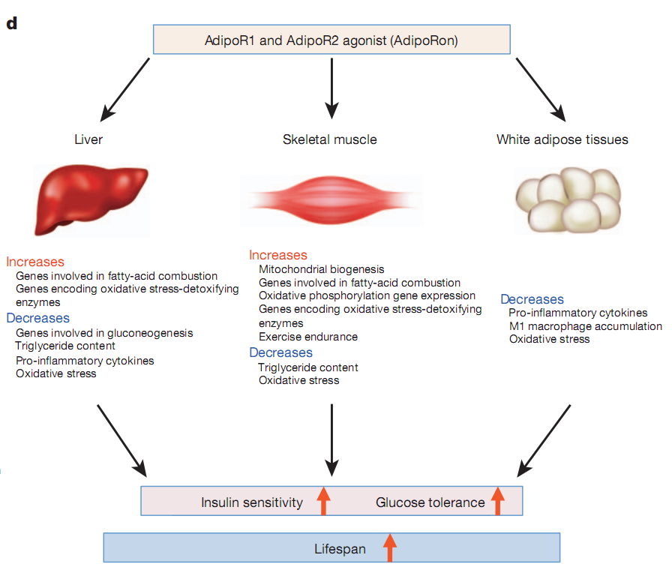
Summary for part 2.3-2.5
AdipoRon
Activates AdipoR1–AMPK–PGC-1α pathways;
Activates AdipoR2–PPARα pathways
Activates AdipoR1–AMPK–PGC-1α pathways
Decreases
Pro-inlammatory cytokines
M1 macrophage accumulation
Oxidative stress

Slide 24
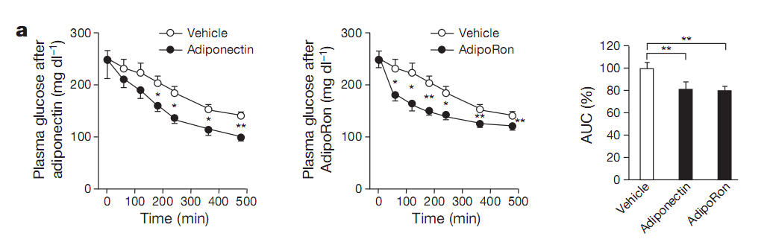
2.6 AdipoRon ameliorates diabetes in db/db mice
2
Results
db/db mice:
Intraperitoneal injectionof adiponectin, and orally administered AdipoRon reduced plasma glucose
Notes:
二型糖尿病模型小鼠（敲除瘦素受体），腹腔注射脂联素和口服AdipoRon，均能够降低血糖水平。两者降血糖能量相当，The area under the curve(AUC)

Slide 25
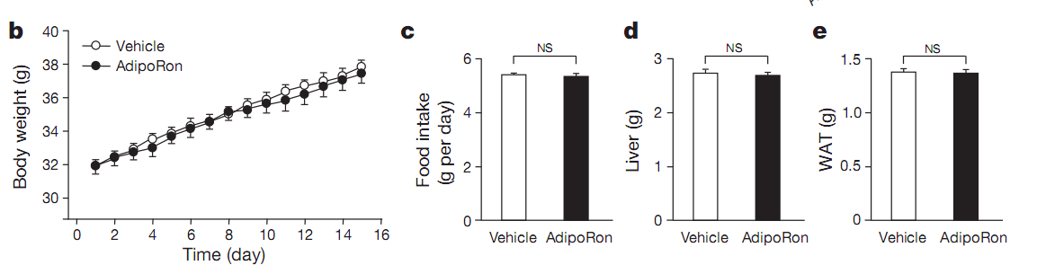
2.6 AdipoRon ameliorates diabetes in db/db mice
2
Results
Orally administered AdipoRon for 2 weeks had no effects on bodyweight, foodintake, liver weight and WAT weight.
Notes:
db/db小鼠口服AdipoRon两周，体重、摄食、肝脏和脂肪重量没有发生变化。

Slide 26
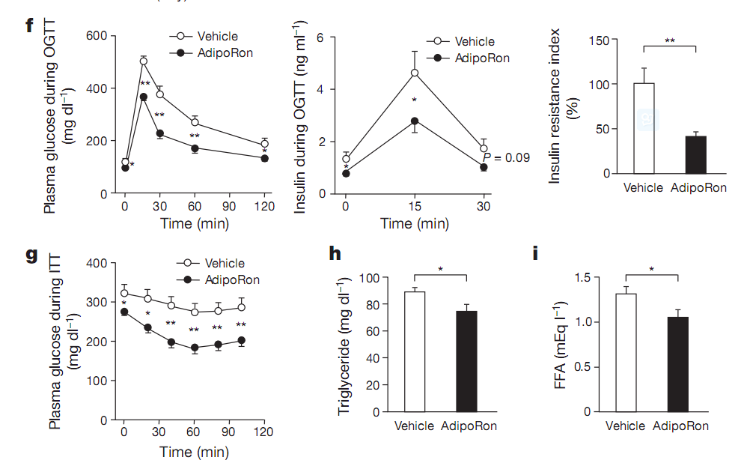
2.6 AdipoRon ameliorates diabetes in db/db mice
2
Results
Orally administered AdipoRon for 2 weeks significantly ameliorated glucose intolerance, insulin resistance and dyslipidaemia in db/db mice fed a normal chow diet.
Notes:
db/db小鼠口服AdipoRon两周，血糖水平、血浆胰岛素水平、胰岛素抵抗指数、胰岛素降血糖能力、血浆TG和FFA均下降。

Slide 27
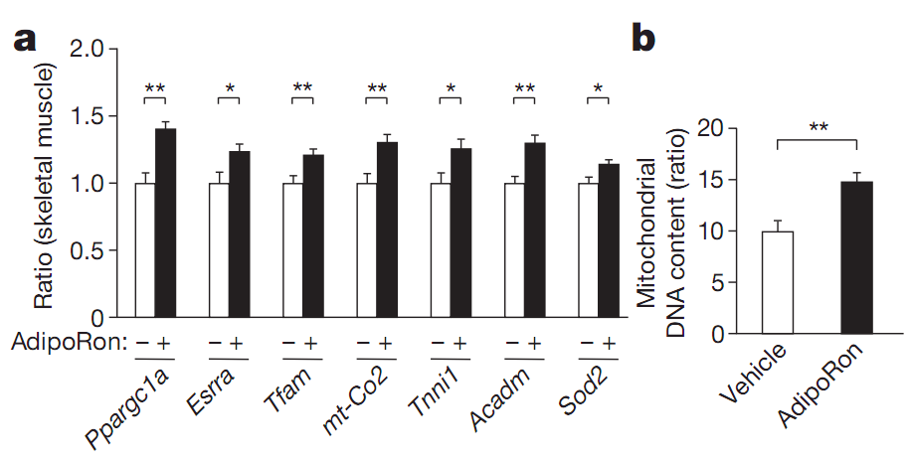
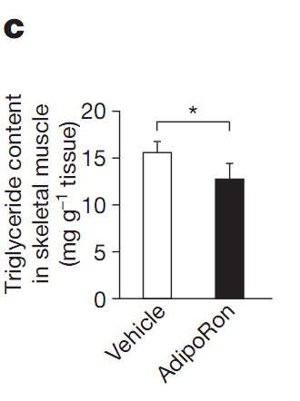
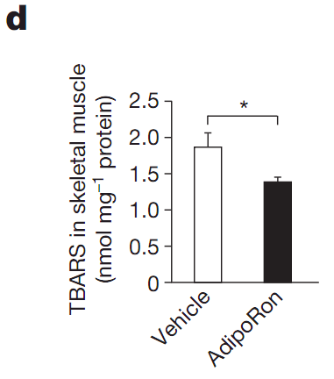
2.6 AdipoRon ameliorates diabetes in db/db mice
2
Results
In the skeletal muscle of db/db mice fed a normal chow diet, AdipoRon significantly increased the expression levels of genes involved in mitochondrial biogenesis functions and DNA content, and also Acadm and Sod2 which were associated with decreased triglyceride content and TBARS, respectively.
Notes:
正常饮食的db/db小鼠，AdipoRon能够促进其肌肉线粒体生物合成相关基因的表达、降低线粒体DNA的含量和抑制脂质过氧化。

Slide 28
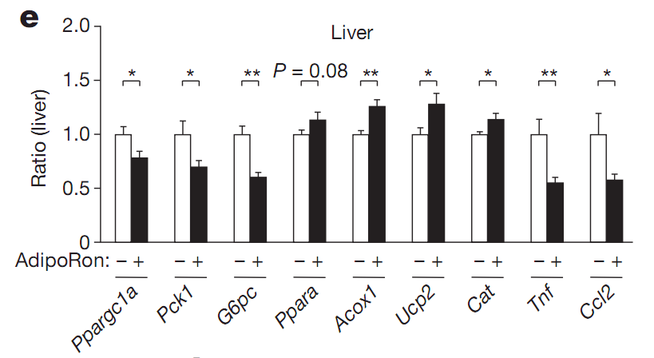
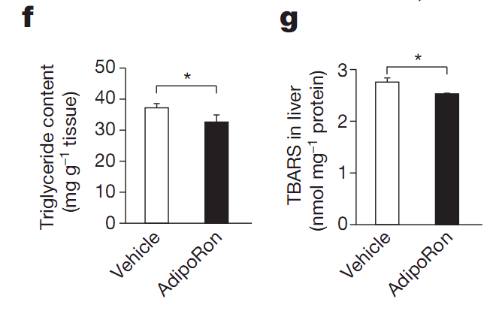
2.6 AdipoRon ameliorates diabetes in db/db mice
2
Results
In the liver, AdipoRon significantly decreased the expression of Ppargc1a, Pck1 and G6pc ,increased the expression of PPARα and its target genes. Therefore, AdipoRon significantly reduced triglyceride content, oxidative stress and reduced the expression levels of genes encoding pro-inflammatory cytokines.
Notes:
AdipoRon能够抑制db/db小鼠肝脏中PGC-1a和糖异生关键酶的表达，促进PPARα及其靶基因的表达（促进脂肪酸氧化），降低TG含量，抑制脂质过氧化。

Slide 29
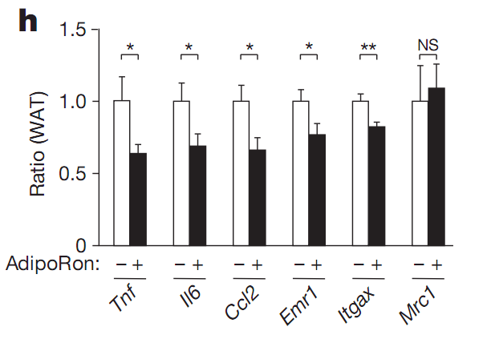
2.6 AdipoRon ameliorates diabetes in db/db mice
2
Results
In the WAT, AdipoRon reduced the expression levels of genes encoding pro-inflammatory cytokines and macrophage markers, especially the levels of markers for classically activated M1macrophages, but not the levels of markers for the alternatively activated M2 macrophages.
Notes:
AdipoRon能够抑制db/db小鼠白色脂肪组织中炎症因子和M1巨噬细胞marker的表达，对M2 marker没有影响。

Slide 30
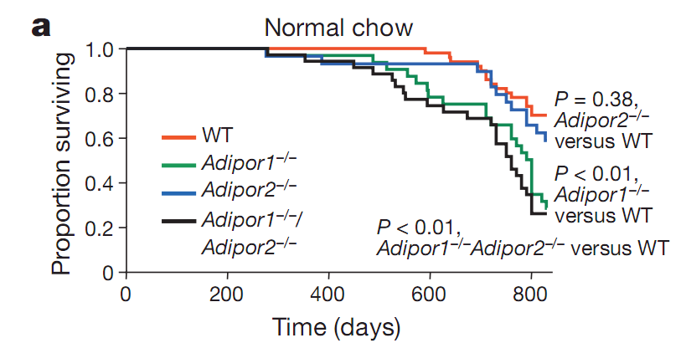
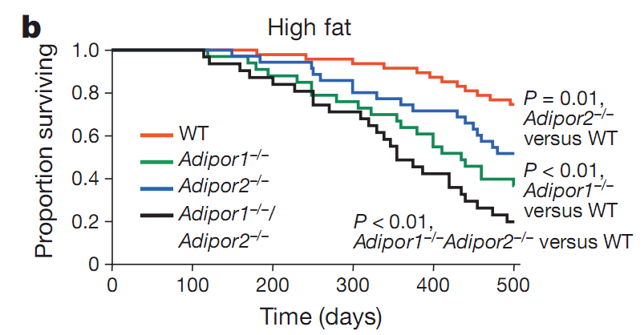
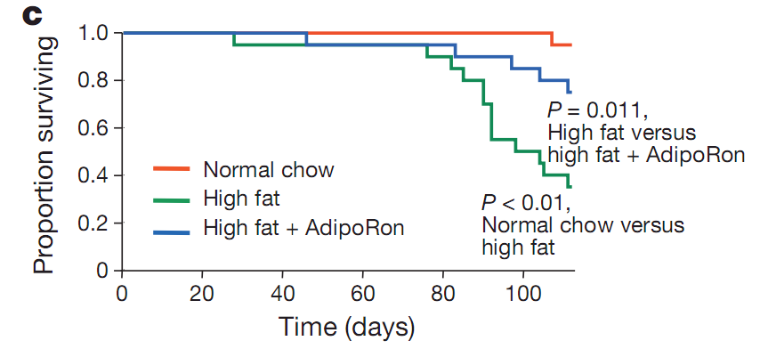
2.7 AdipoRon prolonged the shortened lifespan
2
Results
Notes:
正常饮食和高脂饮食下，双敲除脂联素受体的小鼠寿命缩短。db/db小鼠，高脂饮食寿命缩短，口服AdipoRon能够改善脂饮食引起的寿命缩短。

Slide 31
Summary
Notes:
AdipoRon，通过激活脂联素的受体。
在肝脏中，促进脂肪酸氧化和解除氧化应激酶类等相关基因的表达，抑制糖异生、炎症因子、氧化应激相关基因的表达，降低TG含量；
在骨骼肌中，促进线粒体生物合成，促进参与脂肪酸氧化、线粒体氧化磷酸化、解除氧化应激的相关酶类等基因的表达，增强肌肉运动耐力；降低TG含量和抑制氧化应激
在白色脂肪组织中，抑制炎症因子表达和M1型巨噬细胞的累积，抑制氧化应激。

Slide 32






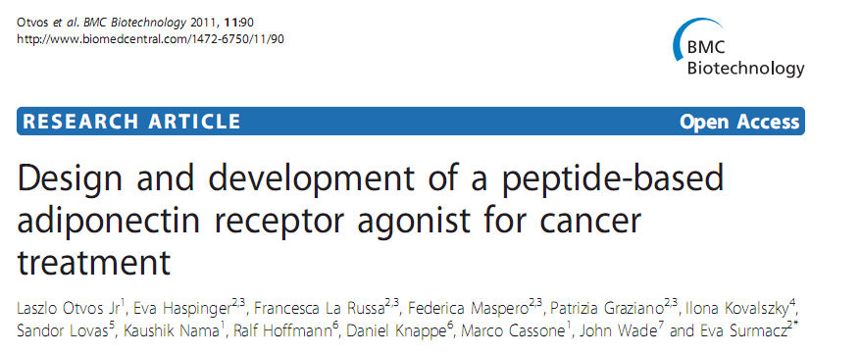
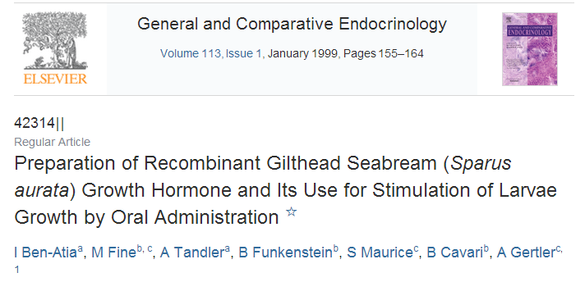
启 发
1
直接应用
内分泌因子
应用与开发
2
筛选受体激活剂
受体
3
配体分子改良
Notes:
金头鲷

