Slide 1

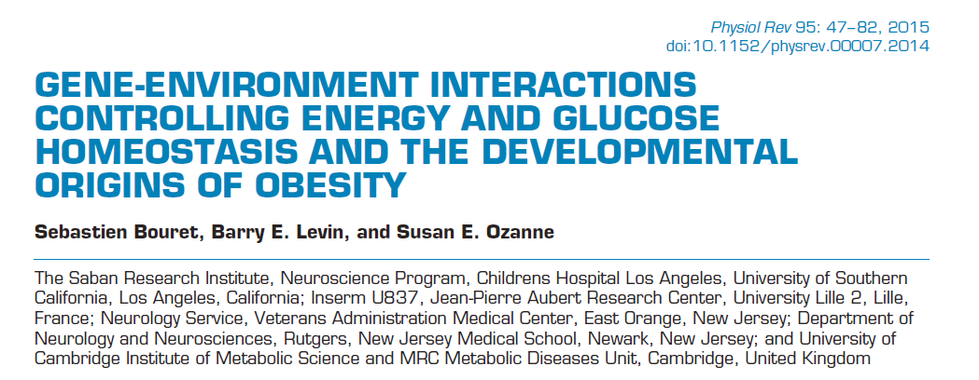


Slide 2

Physiological Reviews

Slide 3
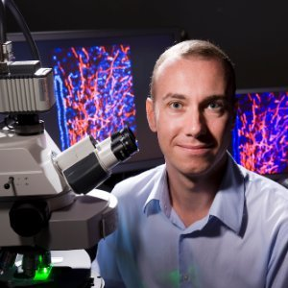
作者信息
Sebastien Bouret
Associate Professor of Pediatrics at University of Southern California & Inserm
Society for Pediatric Research (SPR), 2011-present
Invited speaker, Kavli Japanese-American Frontiers of Science Symposium, 2010
Invited speaker, Japanese-French Frontiers of Science Symposium, 2009

Slide 4


1.The Problem: Obesity, Diabetes, and Their Interactions
?

Slide 5
1.1 Obesity
Overweight is defined as a BMI of 25–29.9 kg/m²
Obesity as a BMI of >30 kg/m².
The category of obesity is further divided into subcategories of class I (BMI 30.0–34.9 kg/m²), class II (BMI 35.0–39.9 kg/m²), and class III (BMI >40 kg/m²) .
Other: waist circumference, waist-hip ratio, as well as percent body fat using DEXA, CT, and MRI.

Slide 6
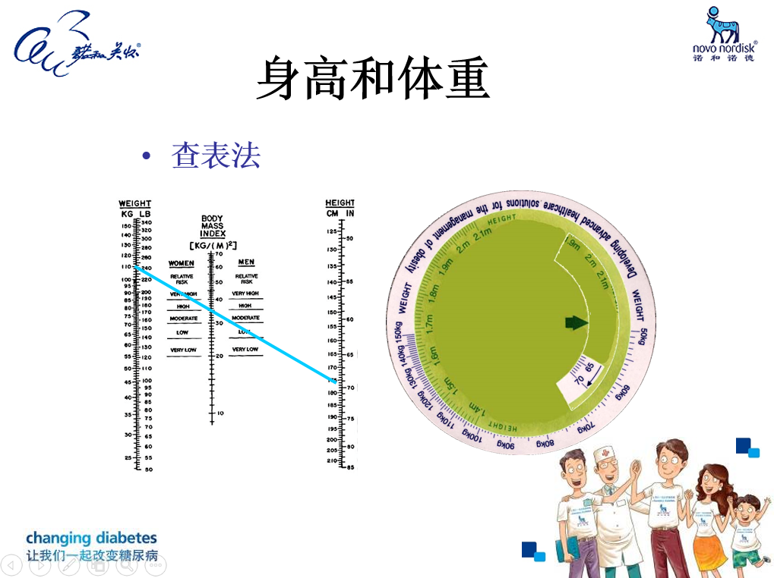

Slide 7
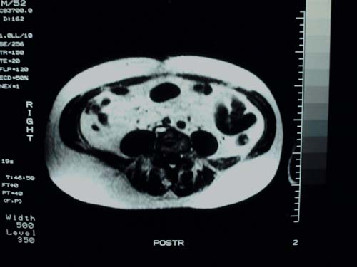
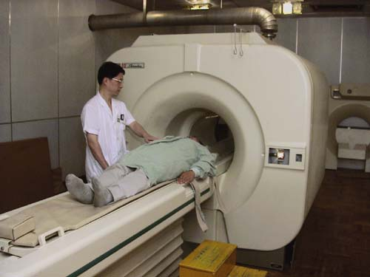
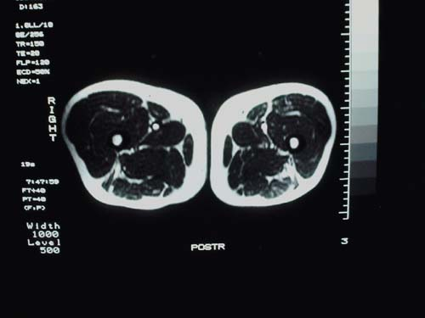
MRI-脂肪测定
SA
VA
FA
计算截面的脂肪面积
Notes:
腔脂肪含量(VA)、腹壁脂肪含量(SA)

Slide 8
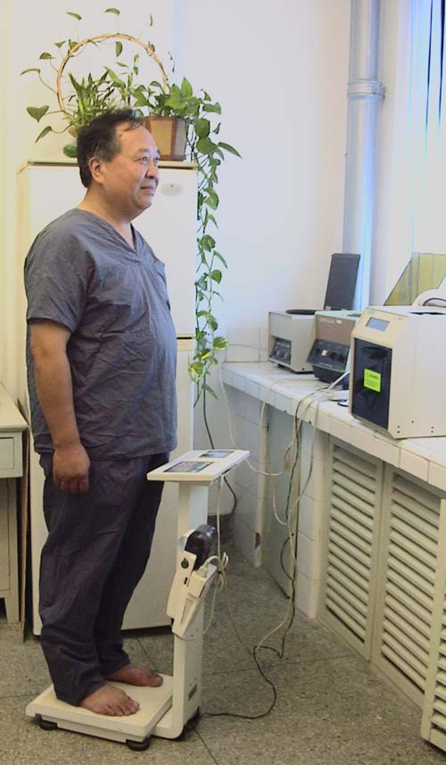
生物电阻抗法（BIA）
原理：脂肪组织导电量不如含电解质的组织，可通过身体导电性或电阻程度计算人体脂肪含量%；
低廉、快速简便，重复性好，适用流行病学调查。

Slide 9


1.2 Diabetes-1 and -2
Hemoglobin A1C of >6.5%, fasting plasma glucose of 126 mg/dl
2h after a 75 g oral glucose tolerance test or a random plasma glucose measurement 200 mg/dl
1型糖尿病T1DM
2型糖尿病T2DM
Notes:
6.5%糖化血红蛋白，空腹血糖126毫克/分升
2h后75 g口服葡萄糖耐量试验或一个随机血浆葡萄糖测量200毫克/分升

Slide 10
1.2 Diabetes-1 and -2
遗传易感性
免疫功能紊乱：针对胰岛β细胞抗原的自身免疫
病毒感染
牛乳喂养
药物及化学物
1型糖尿病T1DM

Slide 11

Diabetes-1 and 2
体力活动减少及/或能量摄入增多
肥胖病（总体脂增多或腹内体脂相对或者绝对增多）
低体重出生儿
中老年
吸烟、药物及应激（可能）
2型糖尿病T2DM

Slide 12

2. Prevalence and Associated Morbidity and Mortality of Obesity
The prevalence of obesity and overweight in the United States is high.
In 2007–2008, 32% of US men and 36% of US women were obese, and an additional 40% of men and 28% of women were overweight.
Cardiovascular disease, T2DM, cancer, and respiratory diseases.
Obesity reduces life expectancy by 6–20 yr depending on age and race.
Notes:
Overweight 超重

Slide 13
3. Genes ×Environment Interactions:
Imprinting (Epigenetics) as a Concept
Although a number of common genetic susceptibility loci for obesity and T2DM have been identified over the last decade, the rapid rise in prevalence of these conditions in the last two decades, a time frame which is not compatible with a change in our genetic make-up, suggests that the environment in which we live is an important determinant of obesity risk.
Highly processed foods that are high in saturated fat and refined carbohydrates as well as reduced physical activity.
?
Notes:
肥胖和T2DM 遗传位点的确立，
但在近二十年内，发病情况快速增加。遗传=发病情况不匹配，是否存在环境因素的影响？

Slide 14
4. Historical Background
4.1 Early concepts of energy homeostasis regulation
4.2 The discovery of leptin and how it changed things
4.3 Early studies implicating the perinatal environment in the pathogenesis of obesity and diabetes
Notes:
早期的研究表明围产期环境在肥胖和糖尿病的发病机制

Slide 15
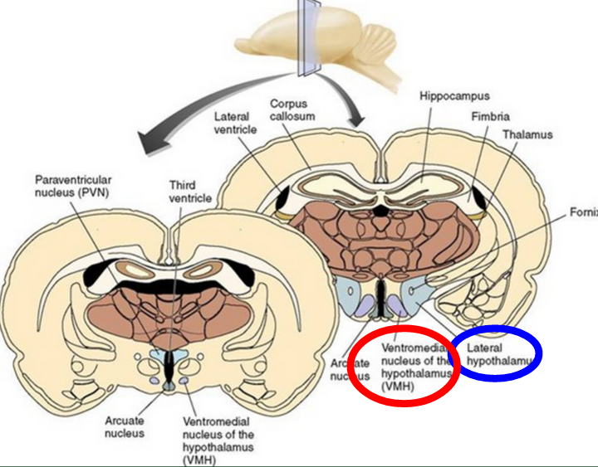
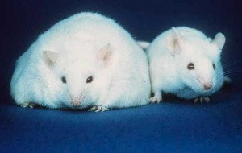
4.1 Early concepts of energy homeostasis regulation
In 1940, Hetherington and Ranson， VMH lesion
VMN and ARC
POMC, NPY, AgRP in the regulation of energy and glucose homeostasis were recognized .

Slide 16
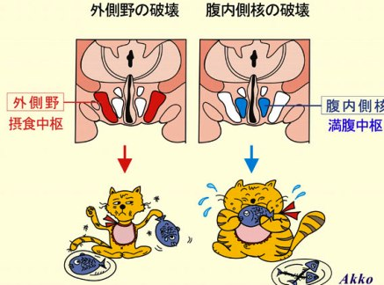
VMH was the “satiety center” and LHA was the “feeding center.”
lateral hypothalamic
area (LHA)
下丘脑腹
内侧核(VMH)
VMH

Slide 17
4.1 Early concepts of energy homeostasis regulation
We eat
Fat gets stored
?
Kennedy, 1953

Slide 18
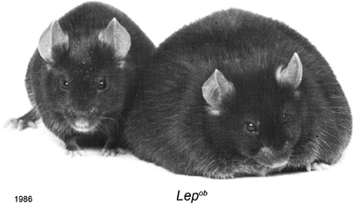
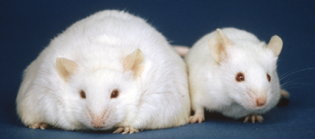
4.2 The discovery of leptin and how it changed things
In 1949, investigators at the Jackson
Ob (now lep)
1966, Coleman and colleagues
Db mouse （糖尿病）
Ob mice lacked a circulating satiety factor and that db mice overproduced that circulating factor but could not respond to it.
Positional cloning，4.5 kb RNA
Friedman named the peptide “leptin”.

Slide 19
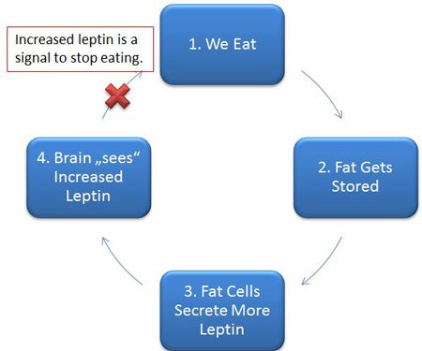
4.2 The discovery of leptin and how it changed things

Slide 20
4.3 Early studies implicating the perinatal environment in the pathogenesis of obesity and diabetes
Early life environment in determining long-term health.
Death rates were most affected by the date of birth and not the year of death.
Forsdahl demonstrating that geographical variations in atherosclerotic disease were not associated with current mortality rates but correlated strongly with past infant mortality rates.
Notes:
早期的研究表明围产期环境在肥胖和糖尿病的发病机制
挪威Forsdahl（155）对近50年后涌现出的研究证明的动脉粥样硬化性疾病变异与目前的死亡率不相关，但与过去的婴儿死亡率强相关。

Slide 21
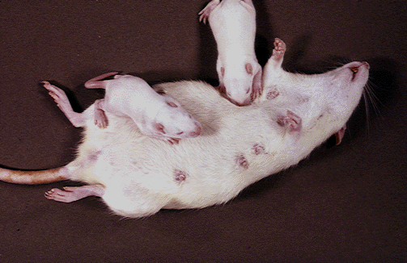
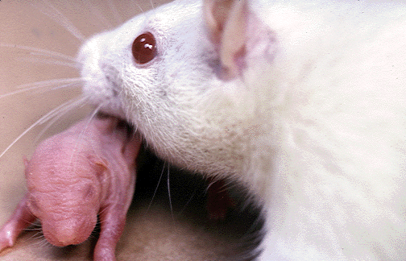
4.3 Early studies implicating the perinatal environment in the pathogenesis of obesity and diabetes
Dutch Hunger Winter
Low nutrient intake during early postnatal life actually reduced the risk of obesity at age 19
Manipulation of litter size.
Appetite determined during the suckling period
Notes:
occurred in the western part of the Netherlands at the end of World War II
产后低营养摄入减少了19岁肥胖的风险。
食欲在哺乳期形成，下丘脑发挥重要作用

Slide 22
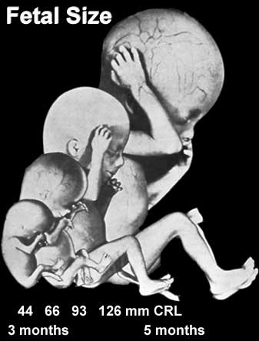
4.3 Early studies implicating the perinatal environment in the pathogenesis of obesity and diabetes
Barker and colleagues：a strong association between birth weight and subsequent risk of development of T2DM and other features of the metabolic syndrome.
Lowest birth weight were around six times more likely to have T2DM or impaired glucose tolerance at age 64 compared with those individuals with the highest birth weight.

Slide 23
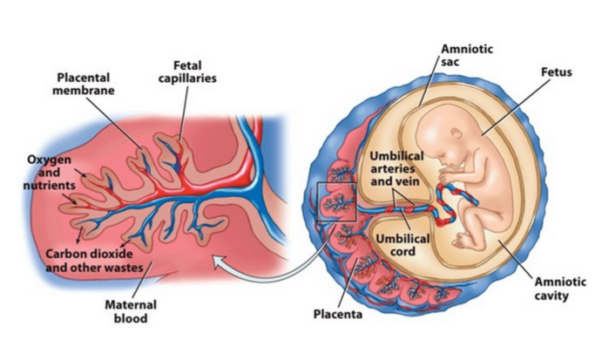
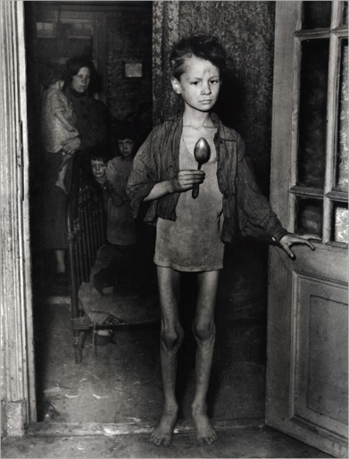
Dutch hunger winter
Maternal nutrition
Long-term risk of T2DM
Before and after Dutch hunger winter: well-nourished population
Dutch hunger winter: onset of the famine and its short duration (5 mo) (1944-1945年荷兰西部)
At age 50， Worse glucose tolerance
Nature Communications

Slide 24
Dutch hungry winter
Leiden大学、哈佛大学和哥伦比亚大学的研究团队对这段时间内孕育的人进行了研究，并将结果发表在近期的Nature Communications杂志上。
比较了Hunger Winter儿童与其兄弟姐妹的DNA，尤其是一百二十万CpG甲基化位点。
环境印迹。
Nature Communications，2014

Slide 25
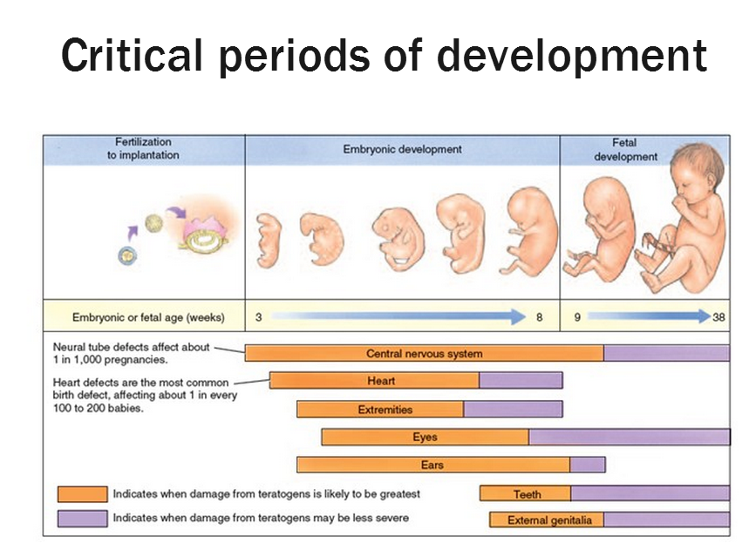

Slide 26
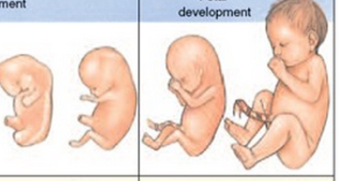
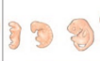
Dutch hungry winter
Vulnerable developmental period in terms of long-term regulation of glucose homeostasis.-late gestation
Risk of cardiovascular disease and obesity ---early gestation
Nature Communications

Slide 27
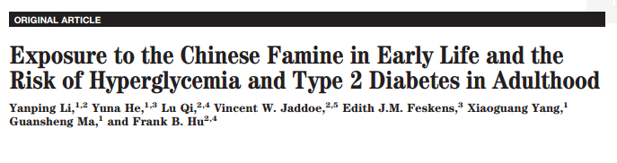
Great Chinese Famine(1959–1961)

Slide 28
5. Central regulation of energy and glucose homeostasis
5.1 The Central-Peripheral Conversation in the Control of Energy and Glucose Homeostasis
5.2 Metabolic Sensing Neurons: the Basic Integrators and Regulators of Glucose and Energy Homeostasis
5.3 Homeostatic and Reward-Based Systems
Schwartz et al., 2003
Notes:
能量和葡萄糖稳态调节
5.1 控制能量和葡萄糖稳态的中枢性外周会话
5.2 代谢感知神经元：葡萄糖和能量平衡的基本集成和调节
5.3 稳态和奖励系统

Slide 29
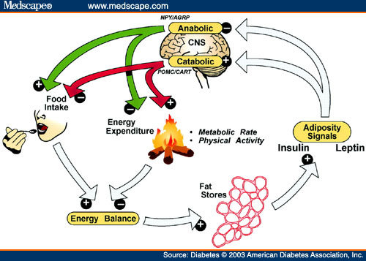
5.1 The Central-Peripheral Conversation in the Control of Energy and Glucose Homeostasis
Schwartz et al., 2003
Notes:
中枢：下丘脑，促进摄食、抑制摄食
能量平衡，脂肪，感知，分泌leptin

Slide 30
5.1 The Central-Peripheral Conversation in the Control of Energy and Glucose Homeostasis
The brain is the controller of energy and glucose homeostasis.
Metabolic signals
Brain
And neural afferents
Schwartz et al., 2003

Slide 31
5.1 The Central-Peripheral Conversation in the Control of Energy and Glucose Homeostasis

Slide 32
5.1 The Central-Peripheral Conversation in the Control of Energy and Glucose Homeostasis
stretch, pain
(内脏)；
Chemical sensor
neural inputs
sensing neurons
Hormones, leptin, Insulin, ghrelin
glucose, free fatty
acids, lactate, ketone bodies, and cytokines

Slide 33
5.2 Metabolic Sensing Neurons: the Basic Integrators and Regulators of Glucose and Energy Homeostasis
In the 1950s Jean Mayer neurons in the hypothalamus that sensed changes in glucose oxidation as a means of regulating feeding.
Until 1964 that Oomura identified such glucosensing neurons.
Glucose
lactate, long-chain fatty acids, and ketone bodies as alternate fuels in some instances
sensing neurons：ambient extracellular levels of glucose and other metabolic substrates are “sensed”
Notes:
乳酸，长链脂肪酸，和酮体

Slide 34
5.2 Metabolic Sensing Neurons: the Basic Integrators and Regulators of Glucose and Energy Homeostasis
Levin et al., 2004

Slide 35
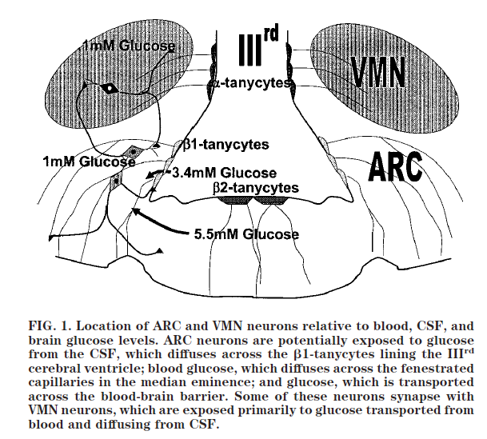
5.2 Metabolic Sensing Neurons: the Basic Integrators and Regulators of Glucose and Energy Homeostasis
Levin et al., 2004

Slide 36
5.2 Metabolic Sensing Neurons: the Basic Integrators and Regulators of Glucose and Energy Homeostasis
合成代谢ARC NPY / AgRP LHA食欲素/食欲素神经元
空腹（低血糖）
葡萄糖抑制
神经元激活
NO、通过AMP激活的激酶和可溶性鸟苷酸的活化环化酶，神经元放电
K_{ATP}通道导致细胞膜去极化、Ca2+通过电压门钙通道激活、动作电位传播，神经递质释放
餐后（高血糖）
葡萄糖兴奋
神经元激活
分解代谢ARC POMC

Slide 37
5.2 Metabolic Sensing Neurons: the Basic Integrators and Regulators of Glucose and Energy Homeostasis
血糖
脑部血糖
摄食
高水平葡萄糖
低水平葡萄糖
抑制摄食
促进摄食
Especially in the brain

Slide 38
5.2 Metabolic Sensing Neurons: the Basic Integrators and Regulators of Glucose and Energy Homeostasis
Many of these same VMH glucosensing neurons are also fatty acid sensors.
Fatty acid translocator/CD36 (which appears to act as a receptor and may also be a transporter of fatty acids) in many VMH neurons.
Impairment of VMH , has no effect on energy homeostasis.
Depletion of VMH neuronal CD36 inhibits linear growth as well as causes redistribution of fat stores from visceral to subcutaneous adipose depots and marked insulin resistance .
Notes:
抑制线性增长以及造成脂肪再分配从内脏到皮下脂肪和明显的胰岛素抵抗。

Slide 39
5.2 Metabolic Sensing Neurons: the Basic Integrators and Regulators of Glucose and Energy Homeostasis
Many of these same VMH glucosensing neurons are also lactate, ketone bodies sensors.
Lactate ketone bodies are produced by astrocytes.
They are also respond to leptin, insulin and ghrelin.
The network of brain areas containing these metabolic sensors forms a distributed network that functions as an integrated system.

Slide 40
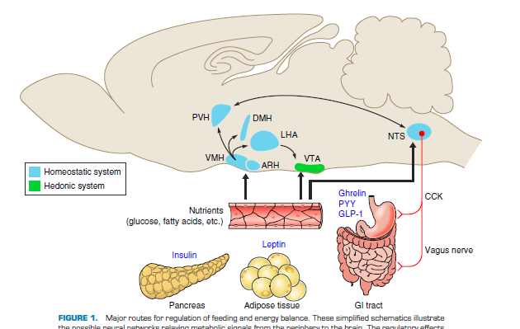
5.3 Homeostatic and Reward-Based Systems
neural circuits
Notes:
PVN 室旁核
ARN 弓状核
VMH 下丘脑腹内侧核
LHA 下丘脑腹外侧核
丘脑背内侧核(DMN)
下丘脑腹侧被盖区ventral tegmental area (VTA),
hedonic system：享乐，药物成瘾

Slide 41
GENETIC BASIS OF OBESITY
PERINATAL ENVIRONMENT AND THE DEVELOPMENT OF OBESITY AND T2DM
GENE-ENVIRONMENT INTERACTIONS
HOW CAN WE USE THIS INFORMATION TO PREVENT AND TREAT OBESITY AND DIABETES?

Slide 42
THANKS!

